Slide 1
Leo Hayes High School
Graduation Prizes
Photos courtesy of:
Mary Ellen Nealis
Photography

Slide 2
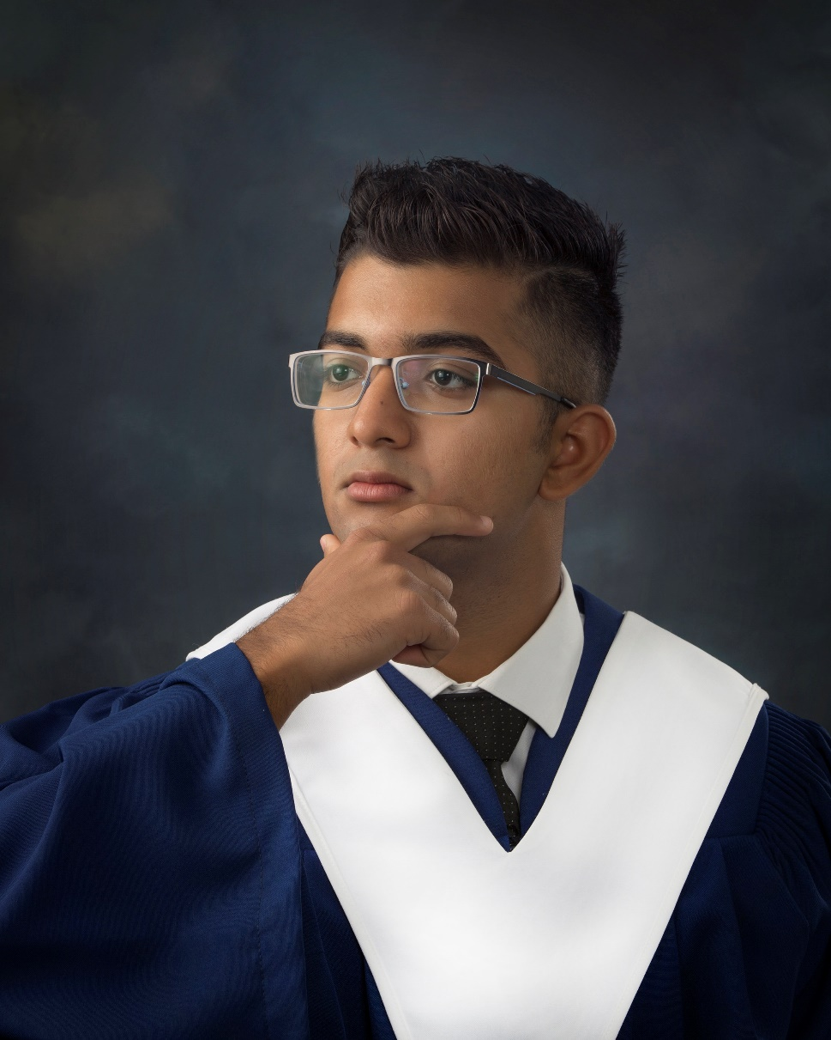
BEN AND FAYE MEDJUCK PRIZE
For a graduate with high aggregate in academic subjects in grade 12.
Rakshit Galwa

Slide 3
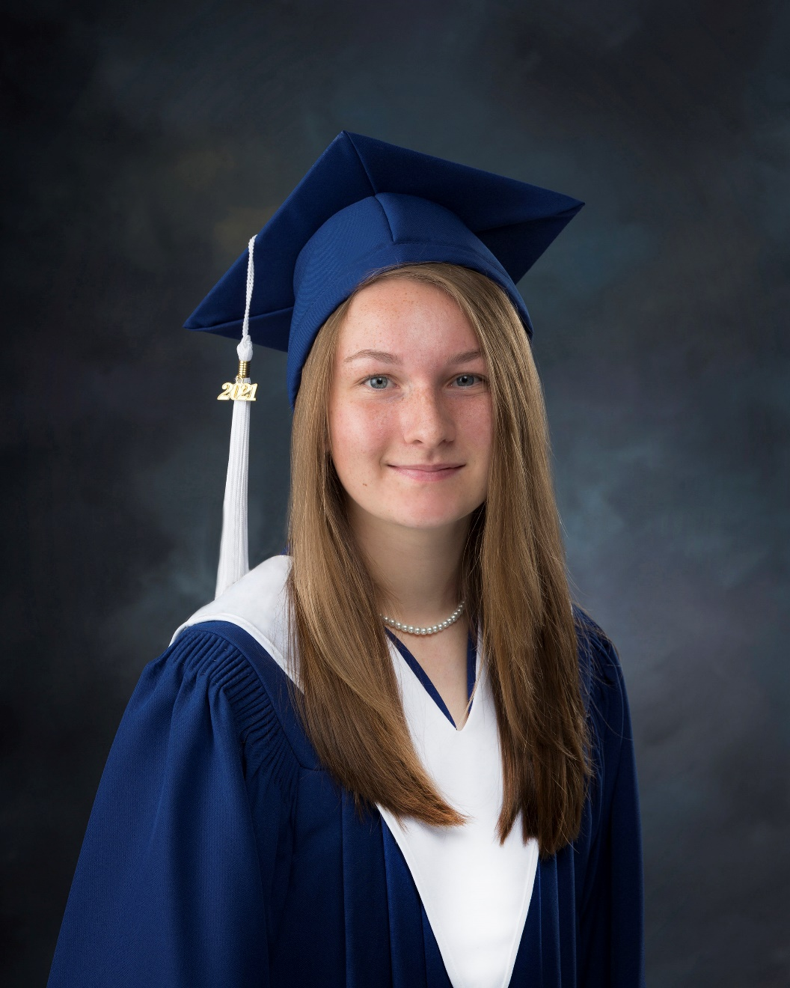
BENS TROPHIES PRIZE
For a deserving
graduate who has achieved excellence in Graphic.
Abigayle Lanteigne

Slide 4
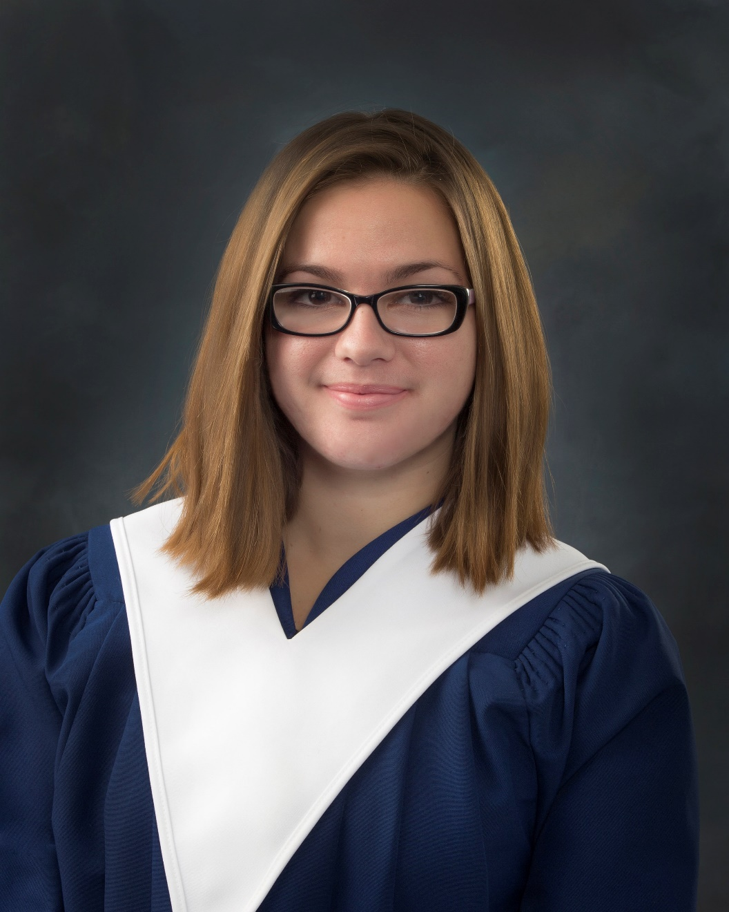
BILL HOGAN MEMORIAL AWARD
For a deserving graduate who has demonstrated perseverance during their progress to graduation.
Tyisha Davis

Slide 5
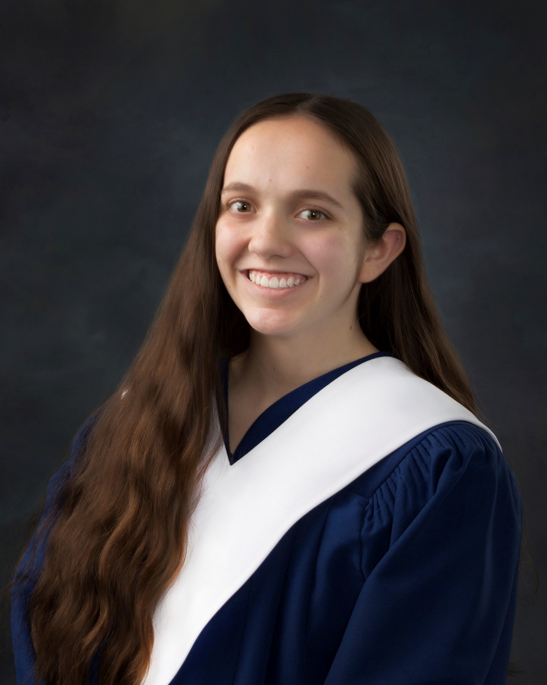
BILL MCCAULAY MEMORIAL MUSIC AWARD
For a worthy student who will be studying music in a post- secondary institution or has been a member in good standing of the music program for all four years of high school.
Chantalle Levesque

Slide 6
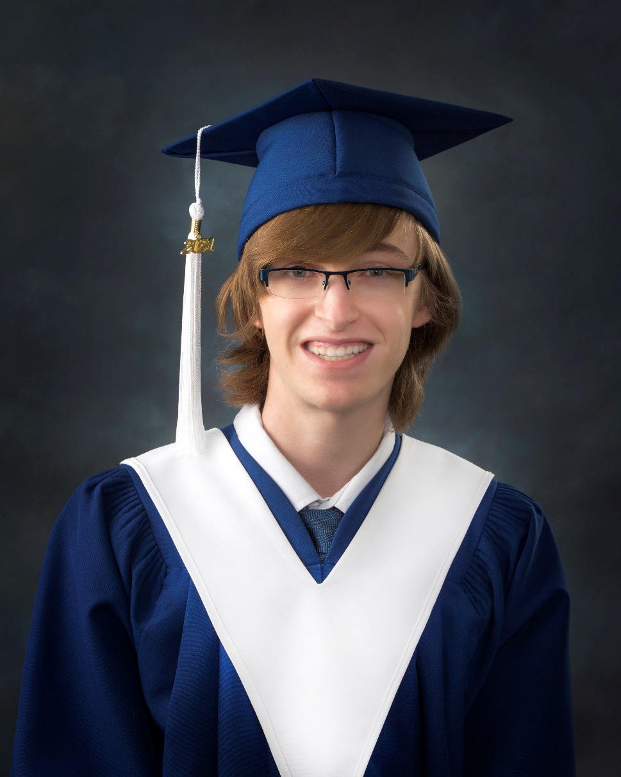
BILL MCCAULAY MEMORIAL MUSIC AWARD
For a worthy student who will be studying music in a post- secondary institution or has been a member in good standing of the music program for all four years of high school.
Ian Murdoch

Slide 7
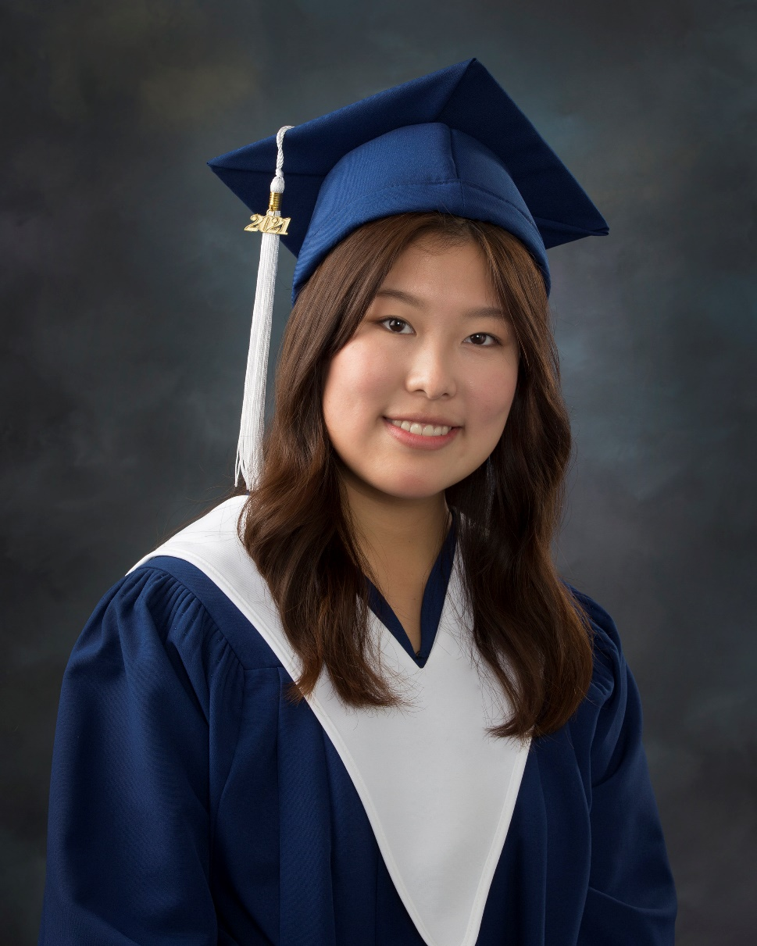
BILL MCCAULAY MEMORIAL MUSIC AWARD
For a worthy student who will be studying music in a post- secondary institution or has been a member in good standing of the music program for all four years of high school.
Joy Shin

Slide 8
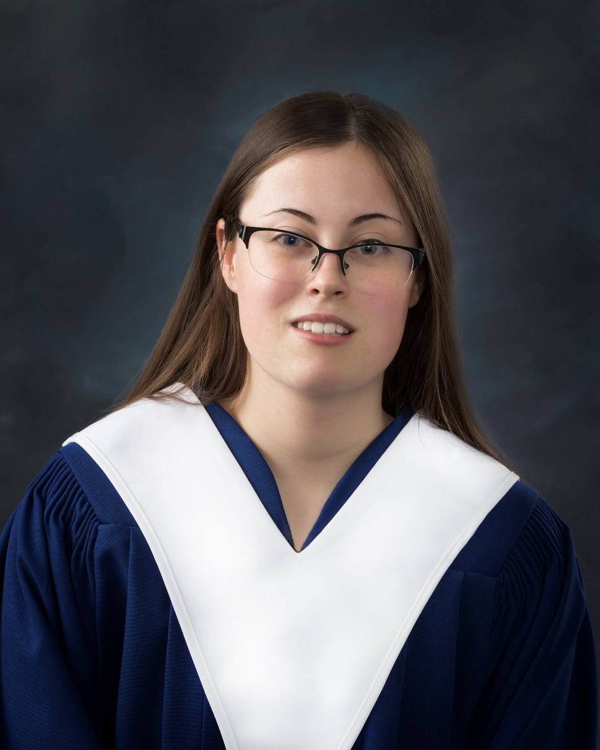
BILL MCCAULAY MEMORIAL MUSIC AWARD
For a worthy student who will be studying music in a post- secondary institution or has been a member in good standing of the music program for all four years of high school.
Marlene Waugh

Slide 9
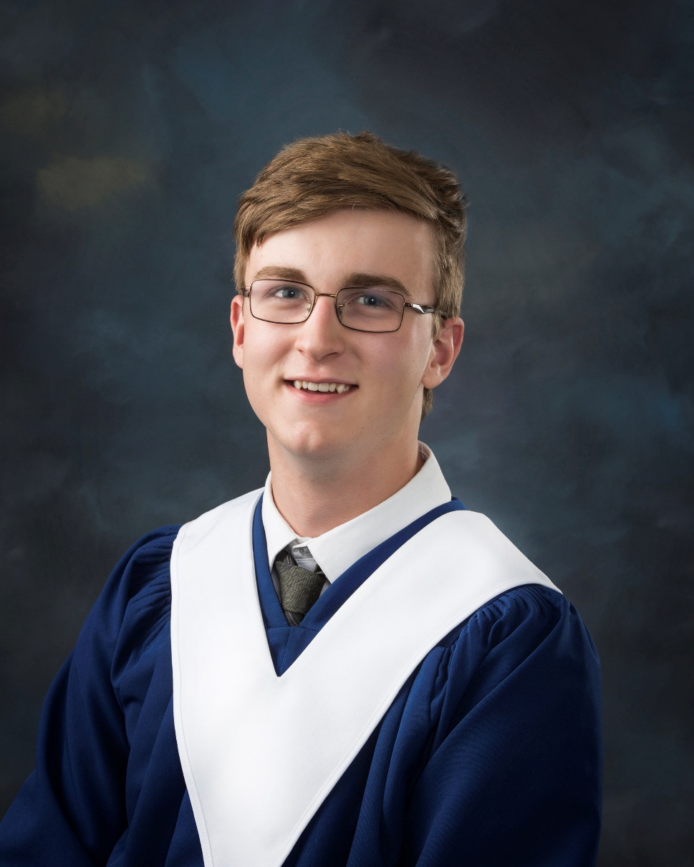
BILL MCCAULAY MEMORIAL MUSIC AWARD
For a worthy student who will be studying music in a post- secondary institution or has been a member in good standing of the music program for all four years of high school.
Ryan Wetmore

Slide 10
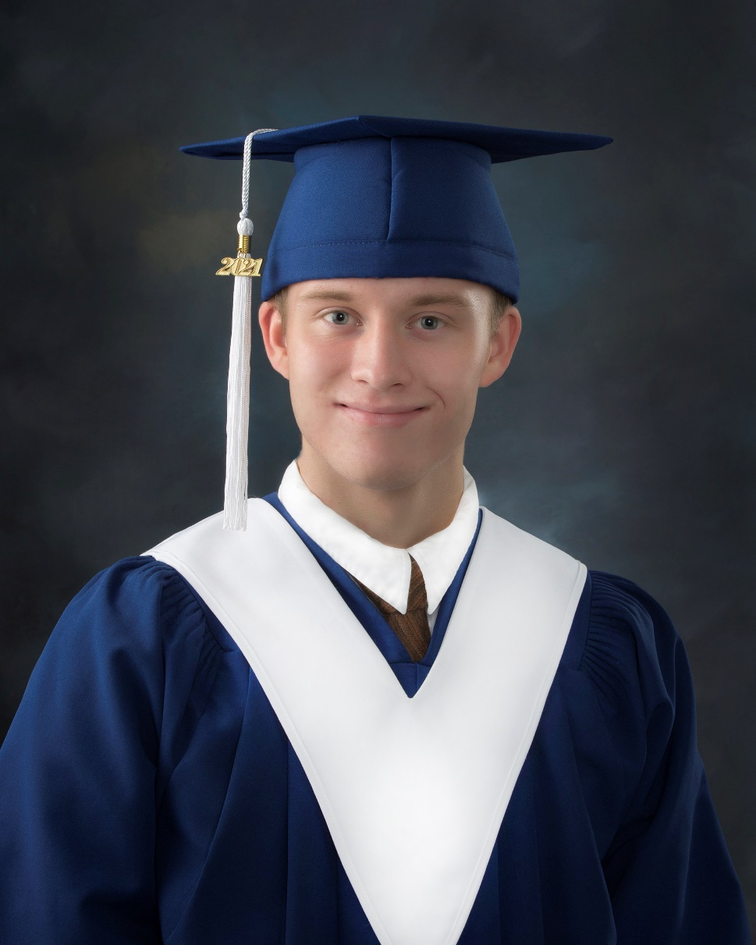
BILL MCCAULAY MEMORIAL MUSIC AWARD
For a worthy student who will be studying music in a post- secondary institution or has been a member in good standing of the music program for all four years of high school.
Gavin Woodward

Slide 11
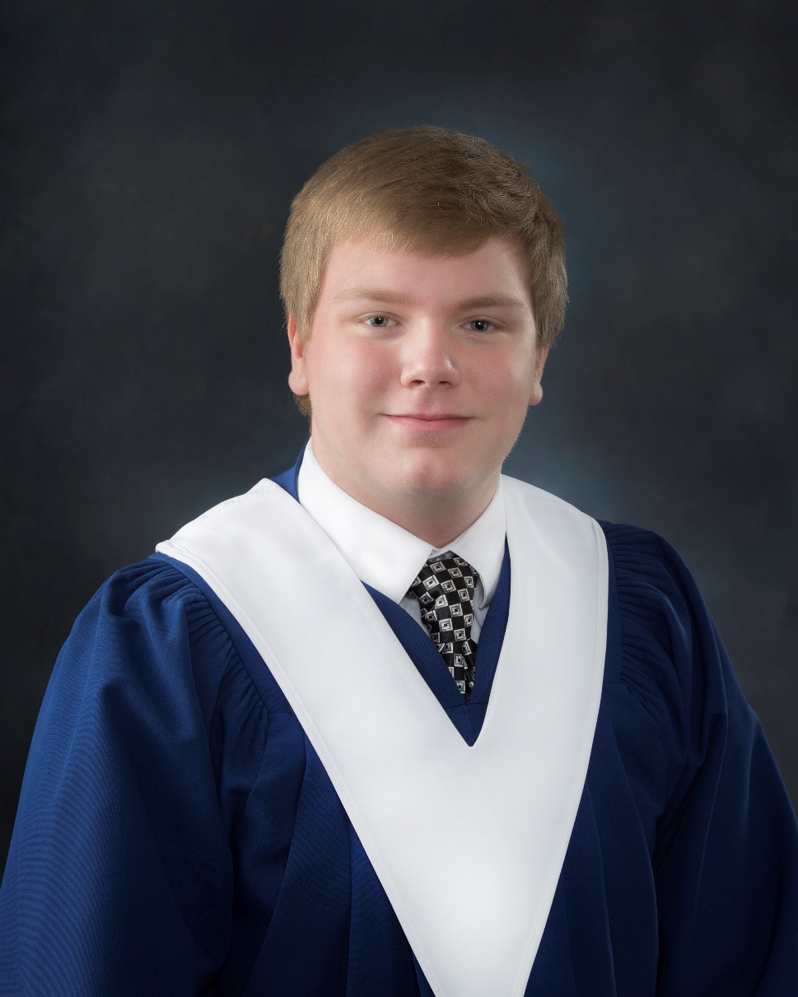
BILL MCCAULAY MEMORIAL MUSIC AWARD
For a worthy student who will be studying music in a post- secondary institution or has been a member in good standing of the music program for all four years of high school.
Connor Yerxa

Slide 12
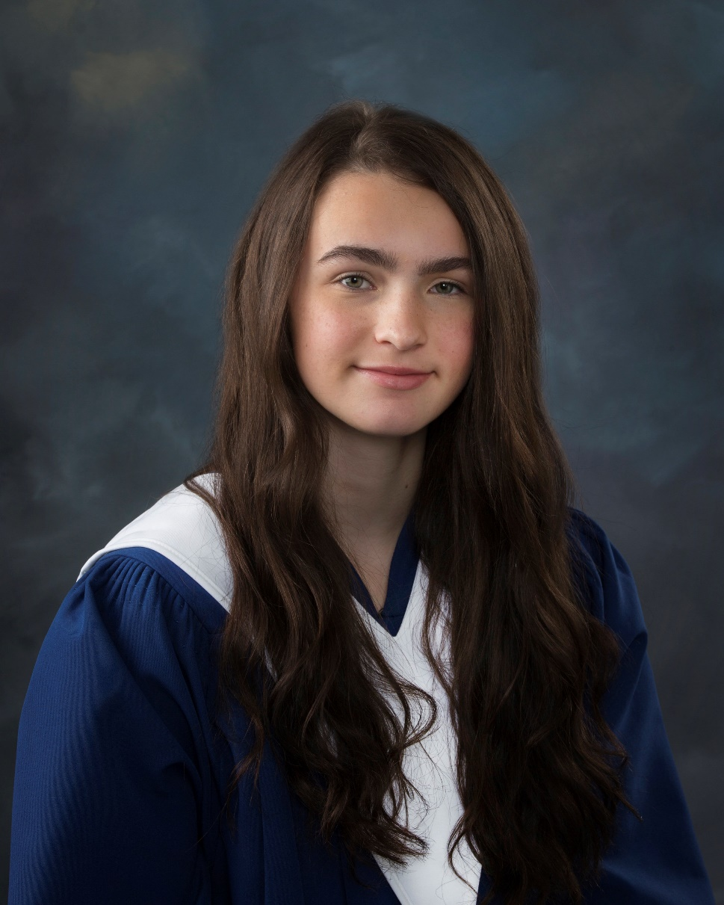
BOURSE DE MÉRITE CERCLE 26 DE L’AEFNB PRIZE
For an immersion graduate who demonstrated a particular interest for French language as well as excellent academic and linguistic competencies.
Elizabeth Shaw

Slide 13
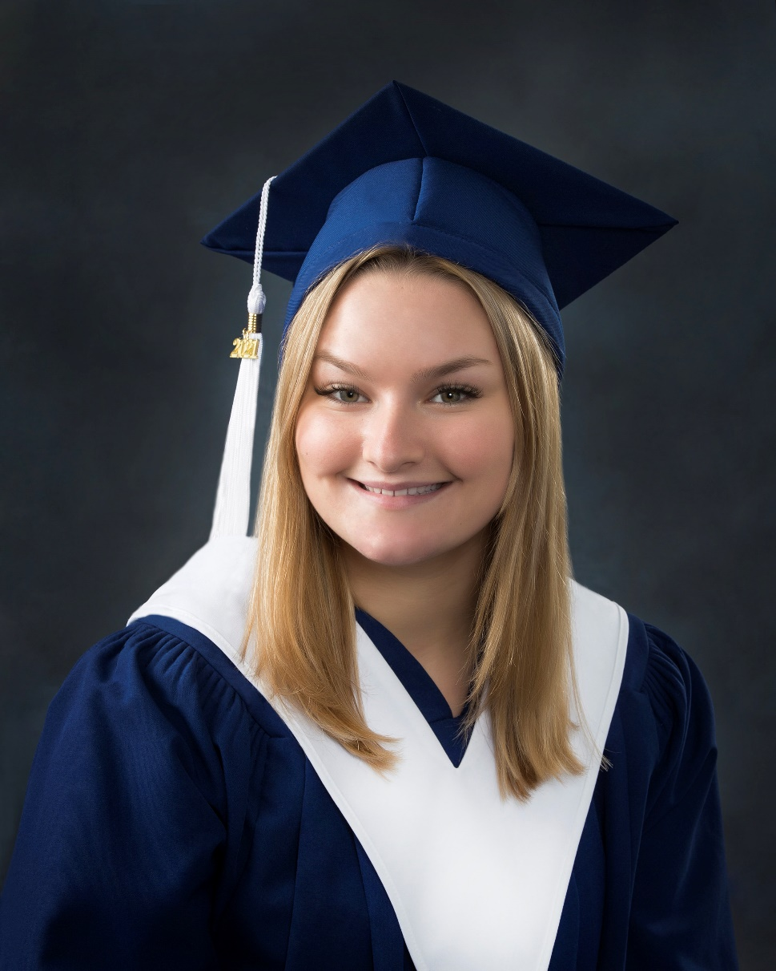
BRENDON ORETO FOUNDATION SCHOLARSHIP
For a graduate who is a well-rounded athlete and student.
Emma Porter

Slide 14
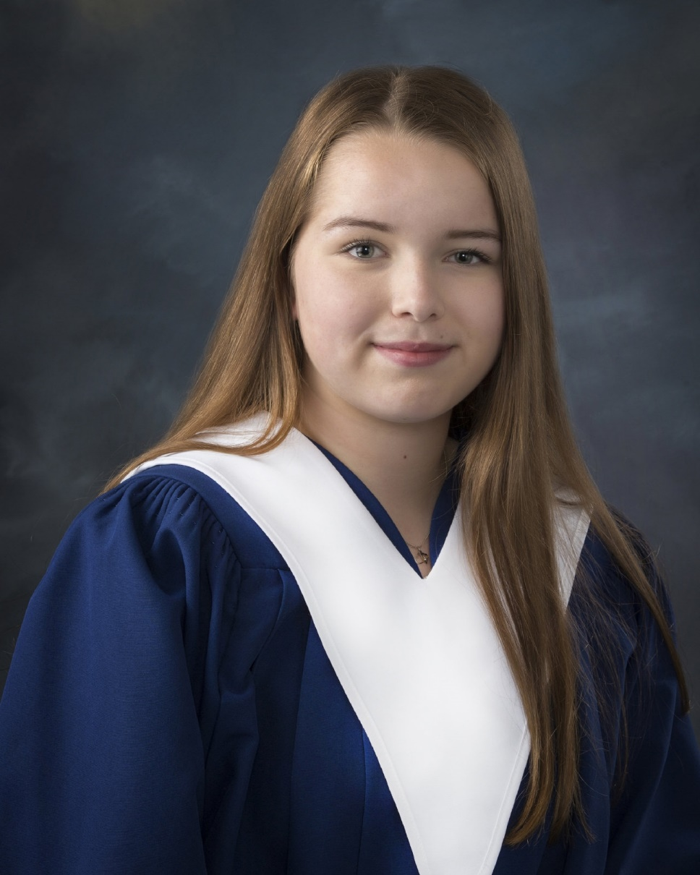
BURTTS CORNER LIONESS
CLUB BURSARY
In memory of Nicole Doiron, for a deserving Burtts Corner student who plans to pursue a post-secondary education in the fall.
Kayleigh Brewer

Slide 15
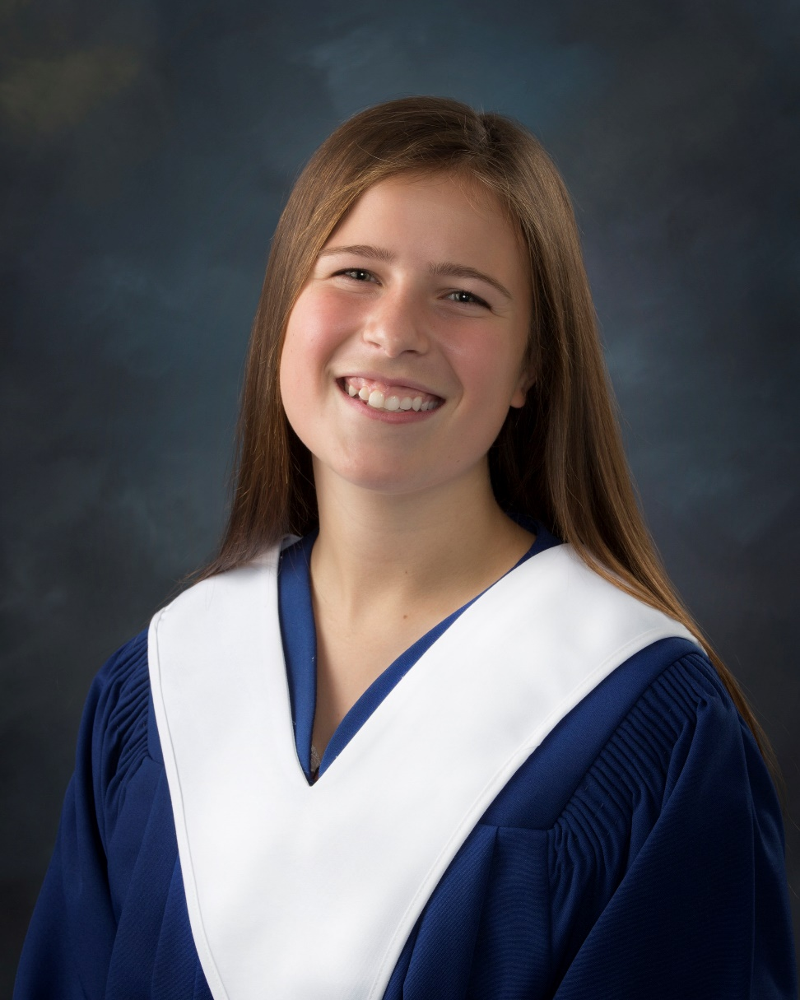
CHRISTIAN LEADERSHIP AWARD
DONATED BY CROSSPOINT WESLEYAN CHURCH & DOUGLAS BAPTIST CHURCH
For a graduate who attended and provided leadership in the LHHS Youth for Christ group throughout his/her high school years
Rebekah Kierstead

Slide 16
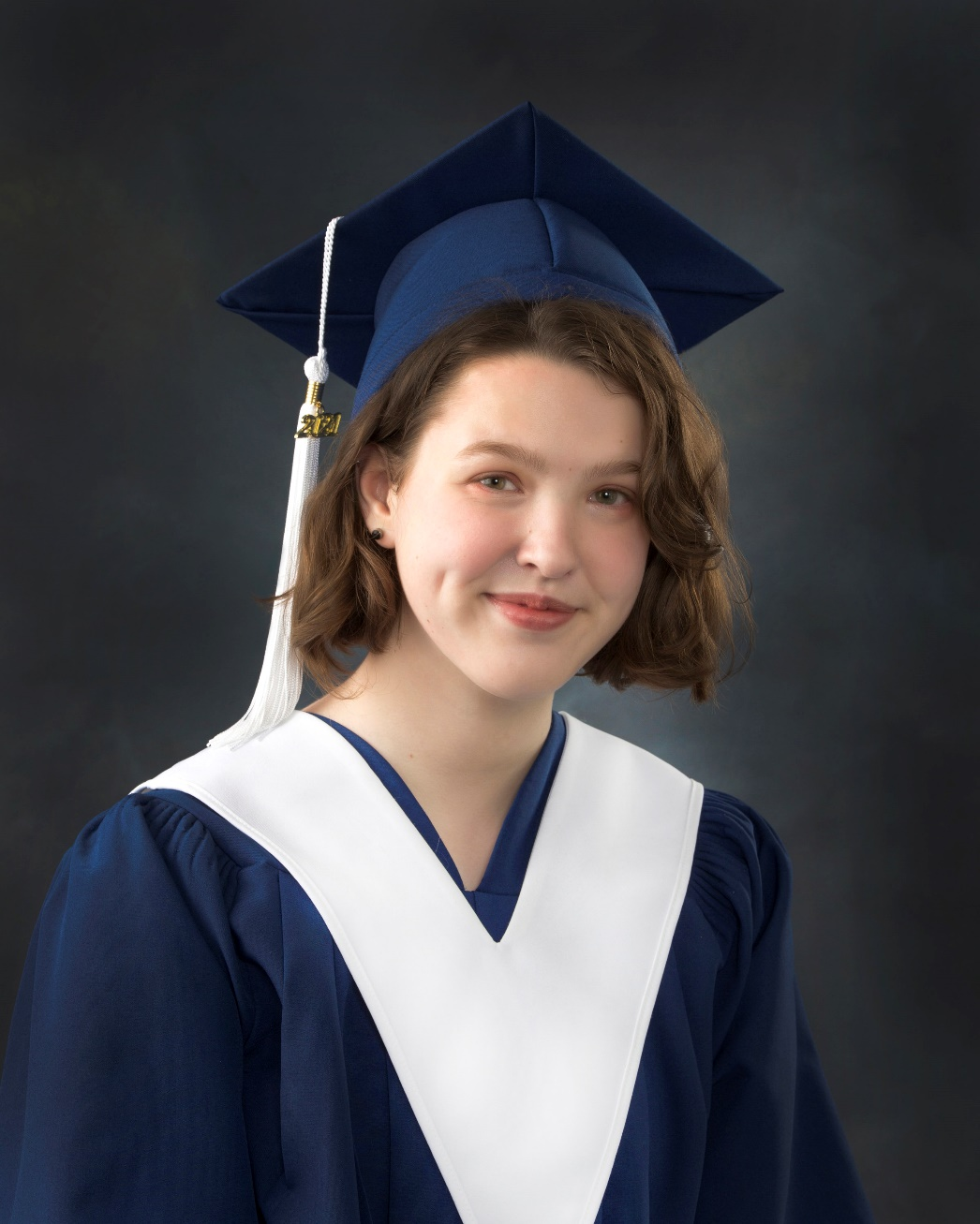
COCA-COLA PRIZE
For a deserving student who has participated in French extra-curricular activities and has completed the French Immersion program.
Jillian Grace

Slide 17
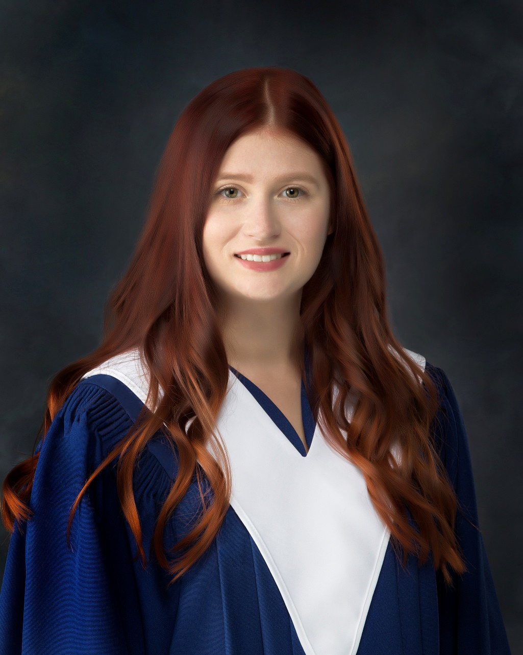
COCA-COLA PRIZE
For a graduate who demonstrated outstanding class leadership and participation in Culinary.
Sarah Marshall

Slide 18
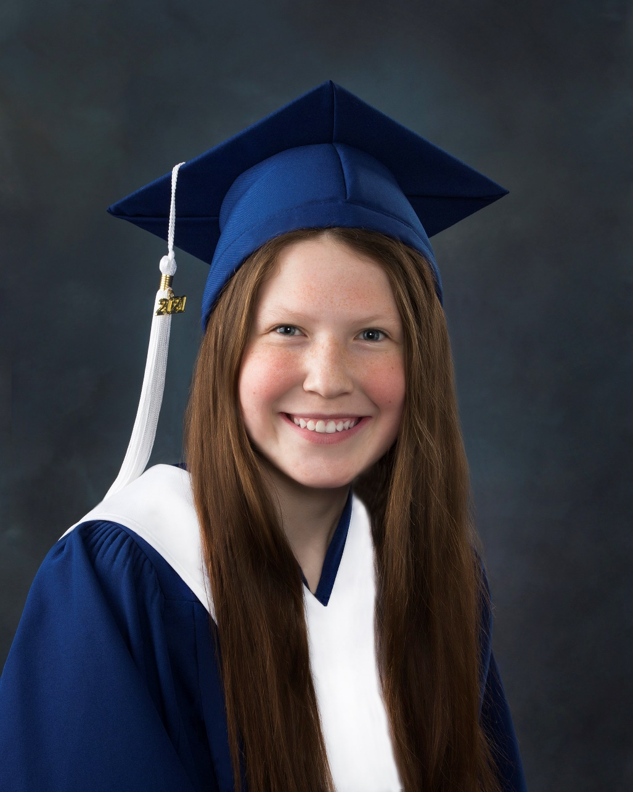
COCA-COLA PRIZE
For a graduate with an interest and aptitude in Canadian History.
Ellie Weir

Slide 19
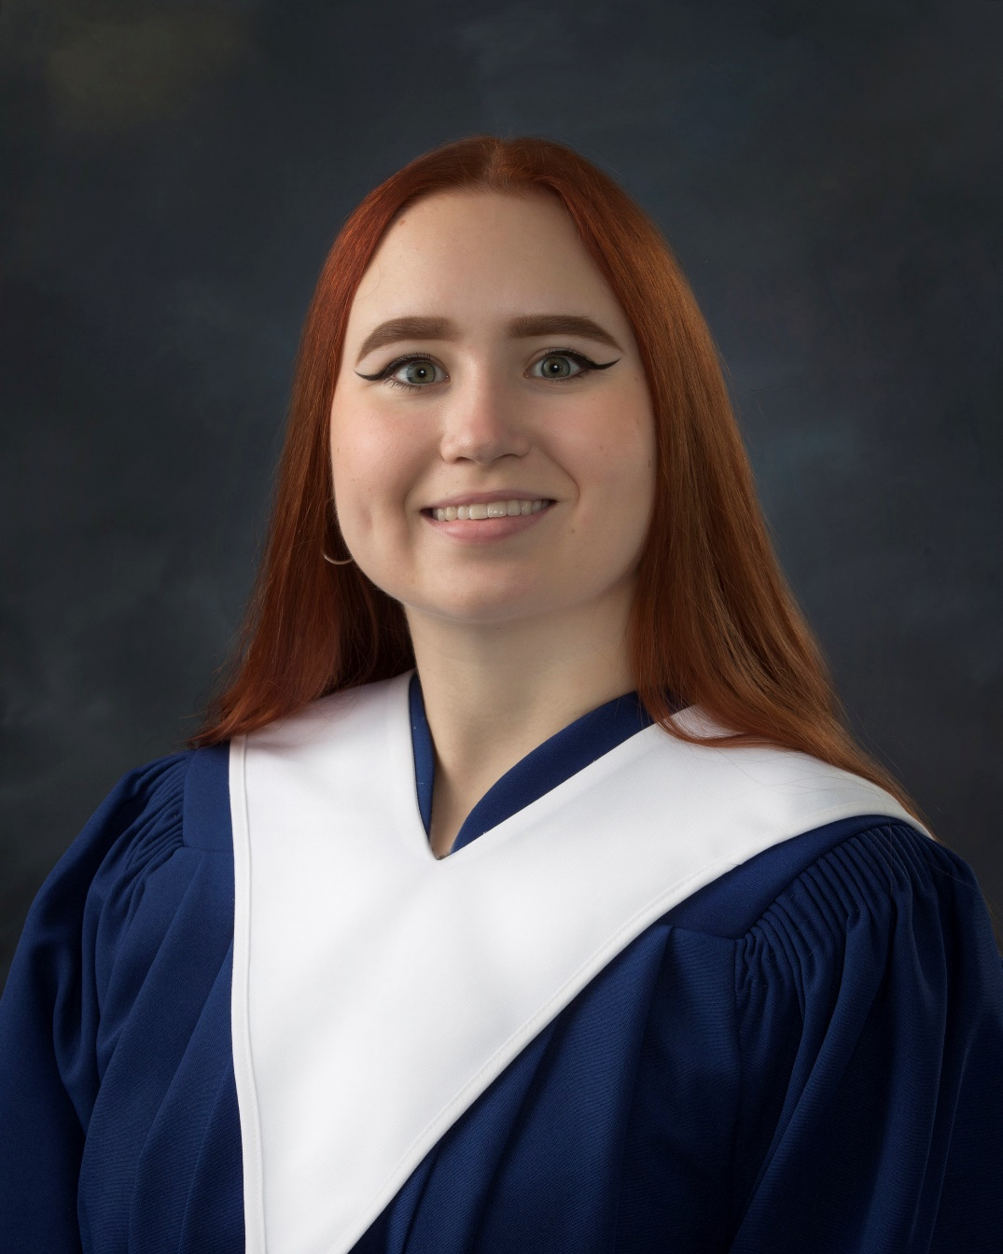
COCA-COLA PRIZE
For a graduate with an interest and aptitude in Physics.
Marina Kurilova

Slide 20
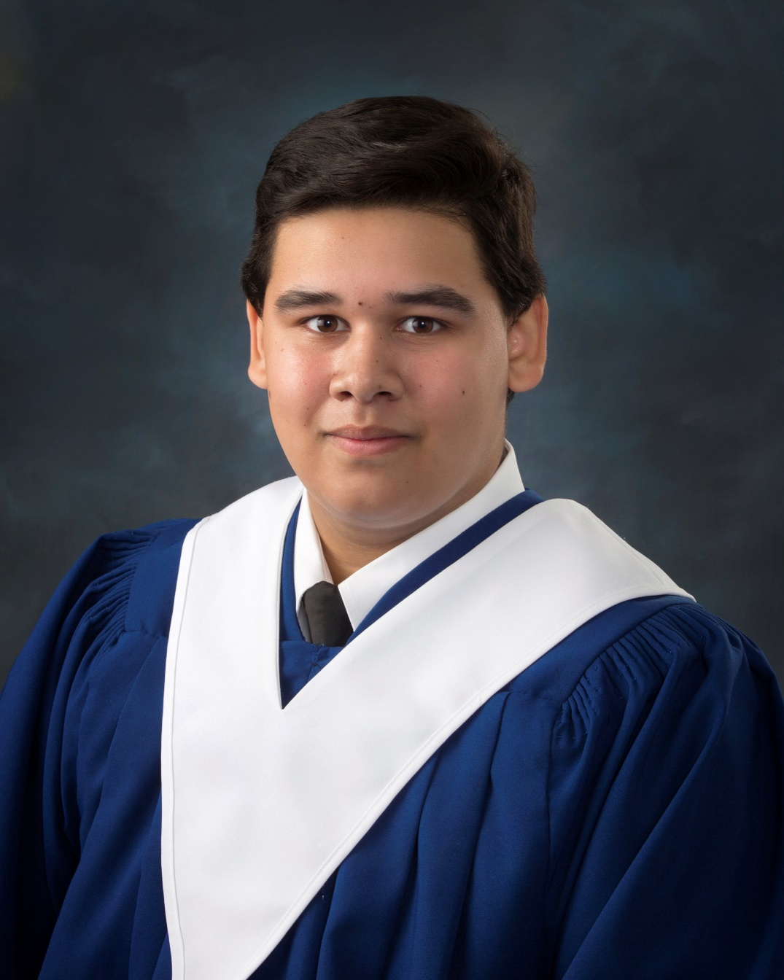
COCA-COLA PRIZE
For a graduate who has demonstrated dedication to the field of mathematics in the pursuit of a career in trades.
Kyle Morehouse

Slide 21
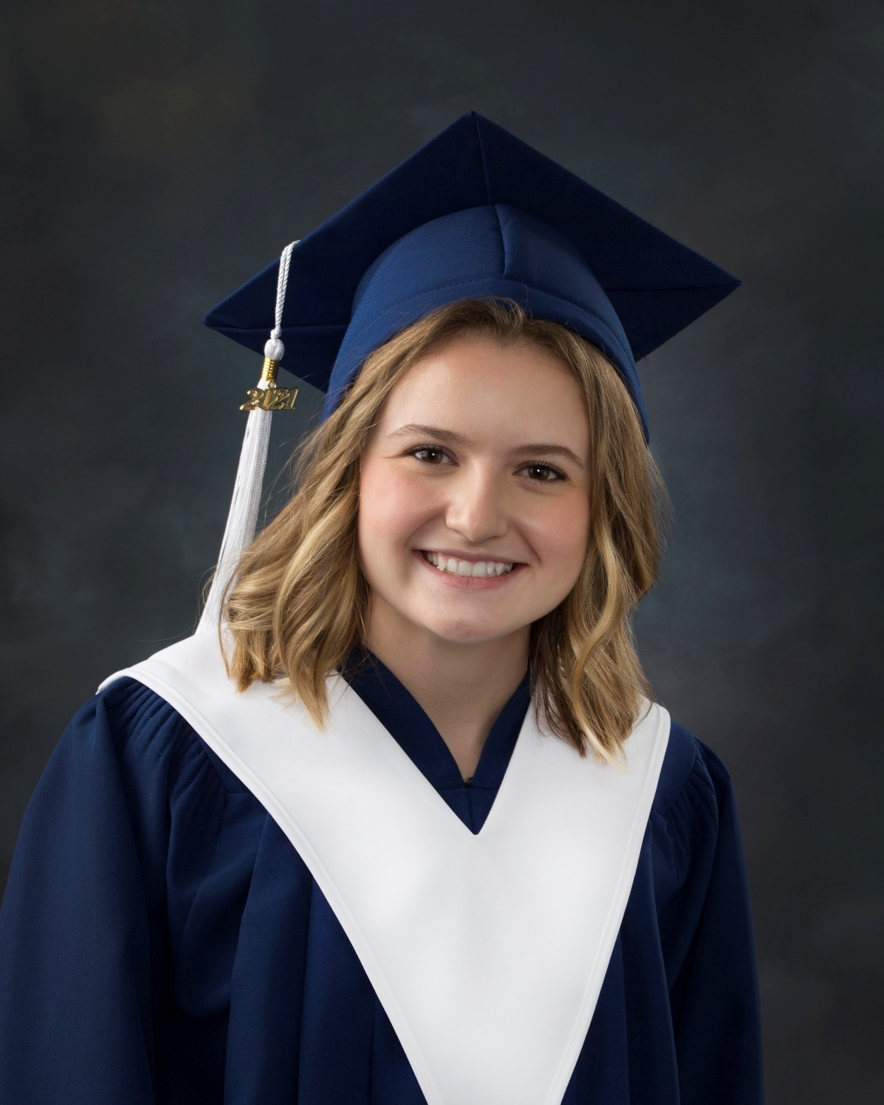
COLTER FAMILY AWARD
For a female graduate who exhibits leadership, academic achievement, community involvement and intends to pursue a post-secondary education.
Kaileigh Surrett

Slide 22
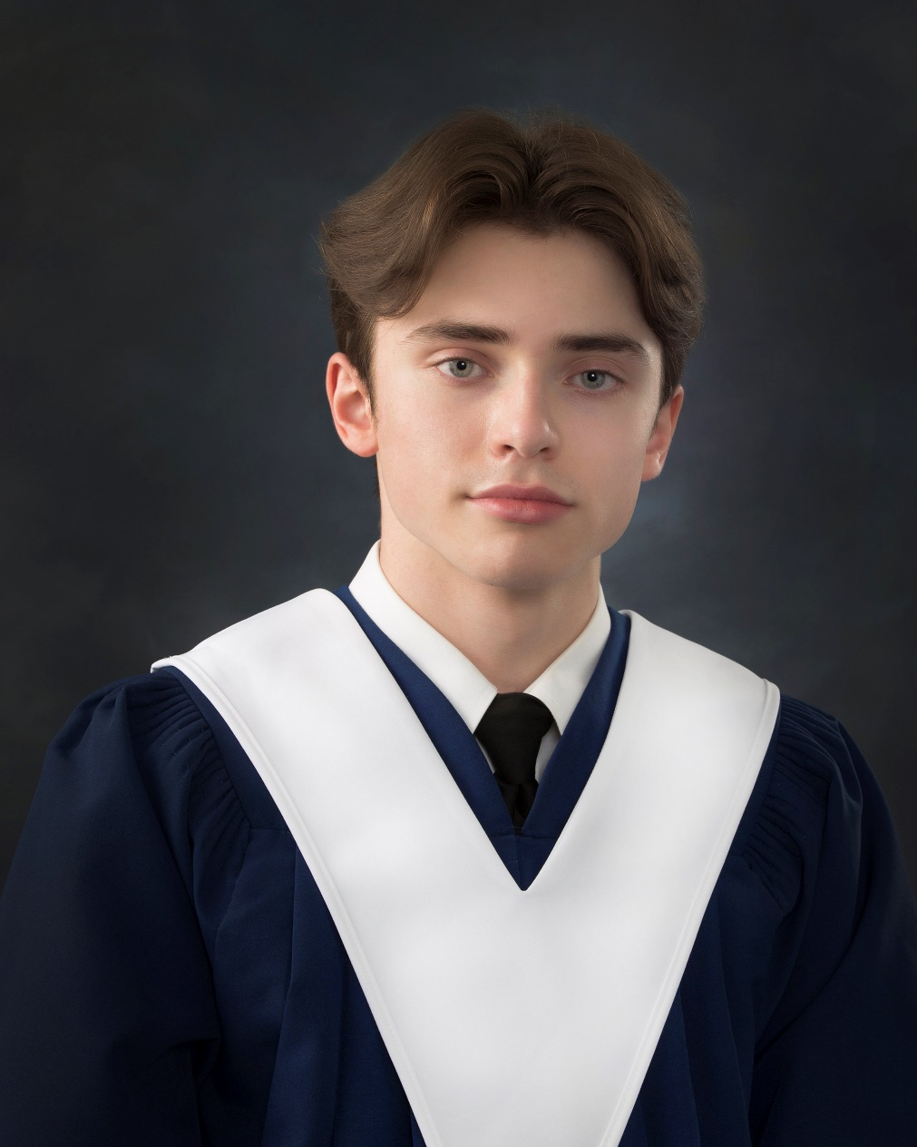
COLTER FAMILY AWARD
For a male student who exhibits leadership, academic achievement, community involvement and intends to pursue a post-secondary education.
Samuel Hawkes

Slide 23
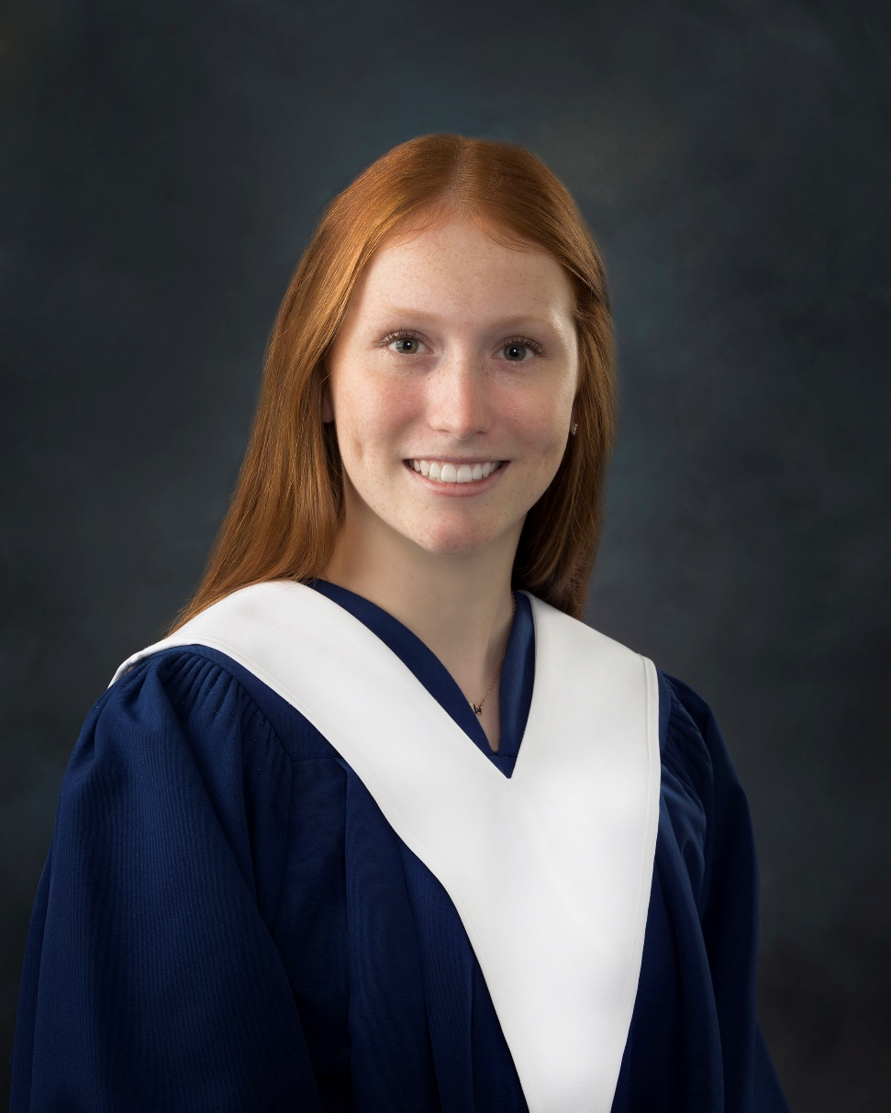
CONGREGATION OF NOTRE DAME PRIZE
For a deserving female graduate who is pursuing study in the area of Science.
Kathryn Oulton

Slide 24
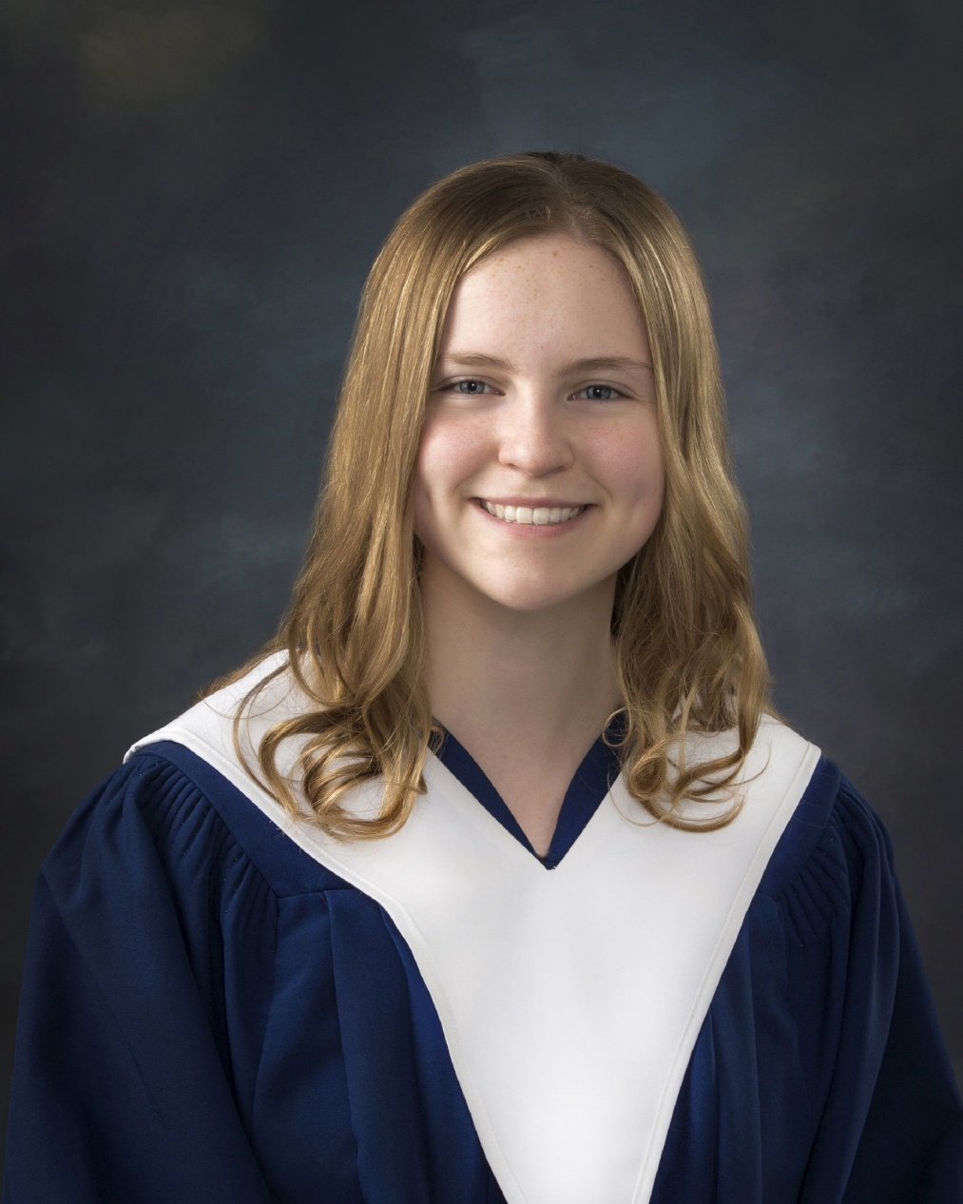
DOUGLAS S. BIGGS BURSARY
For a female graduate with high academic achievement who will be attending the University of New Brunswick.
Jenna Campbell

Slide 25
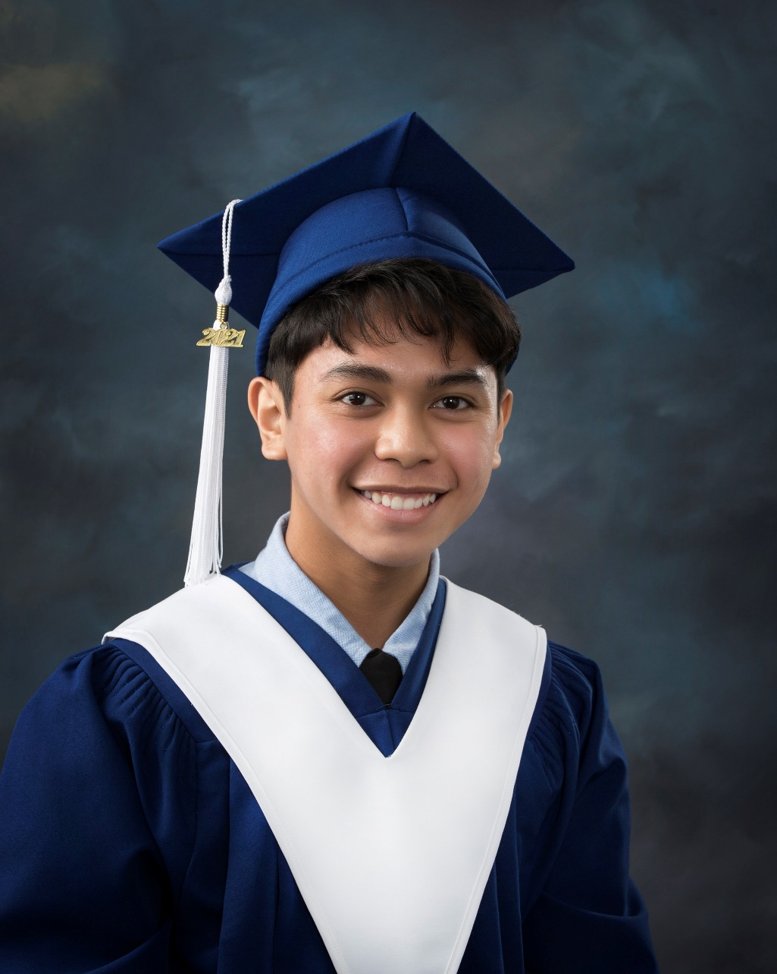
DOUGLAS S. BIGGS BURSARY
For a male graduate with high academic achievement who will be attending the University of New Brunswick.
Japhet Ramos

Slide 26
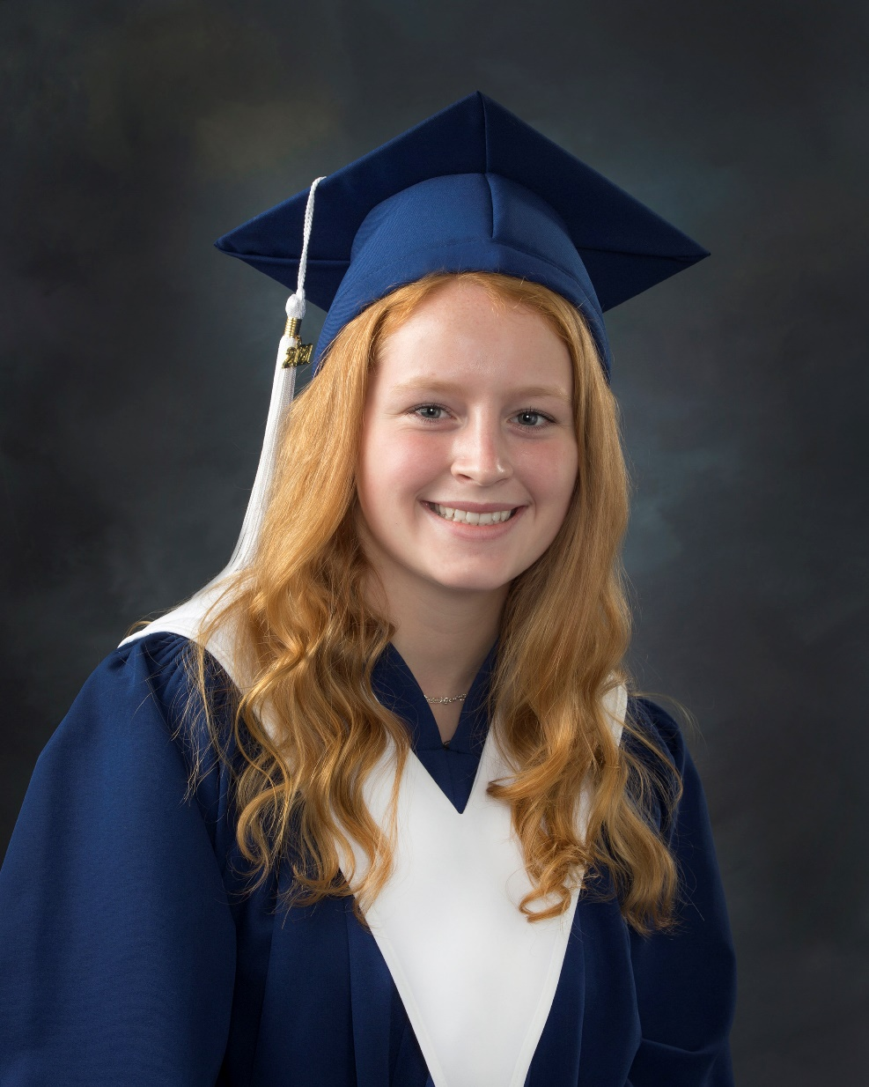
DUNBAR CONSTRUCTION LTD.ENGINEERING PRIZE
For a deserving graduate enrolling in Engineering at the University of new Brunswick.
Abigail Thomas

Slide 27
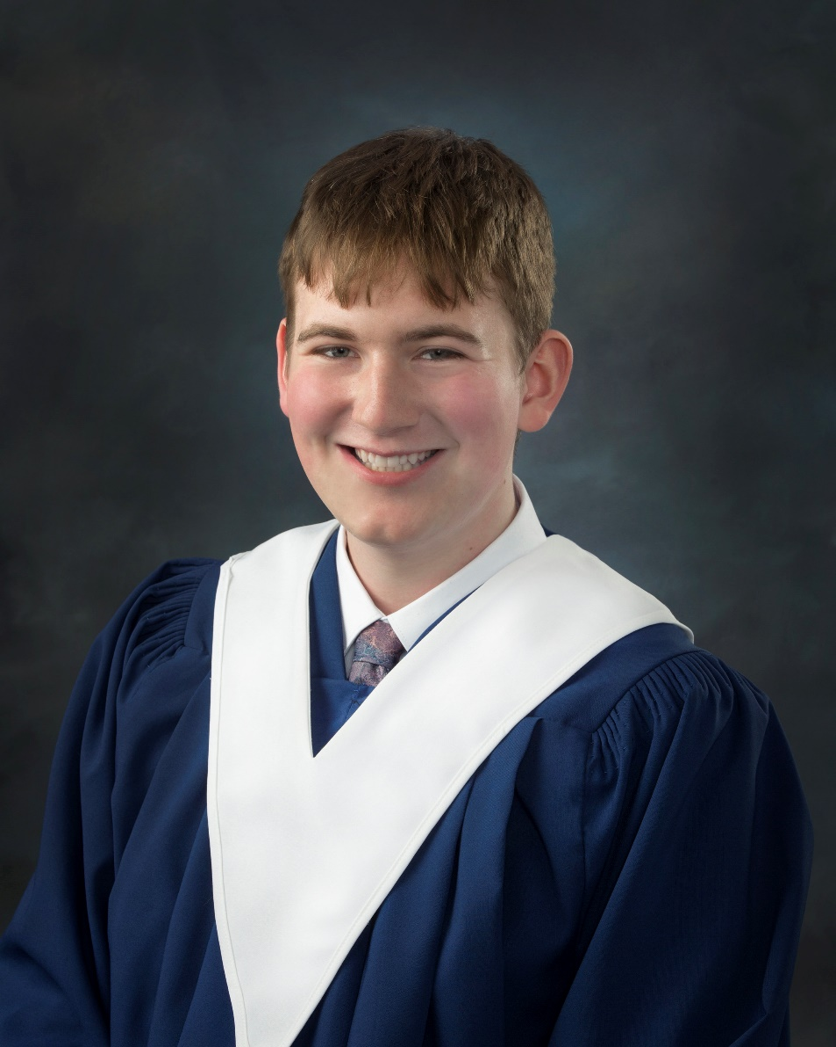
For a graduate who excelled in mathematics and showed a keen interest in studying and learning mathematics outside the classroom.
EASTERN DESIGNERS AND COMPANY LIMITED PRIZE
Keaton Tapley

Slide 28
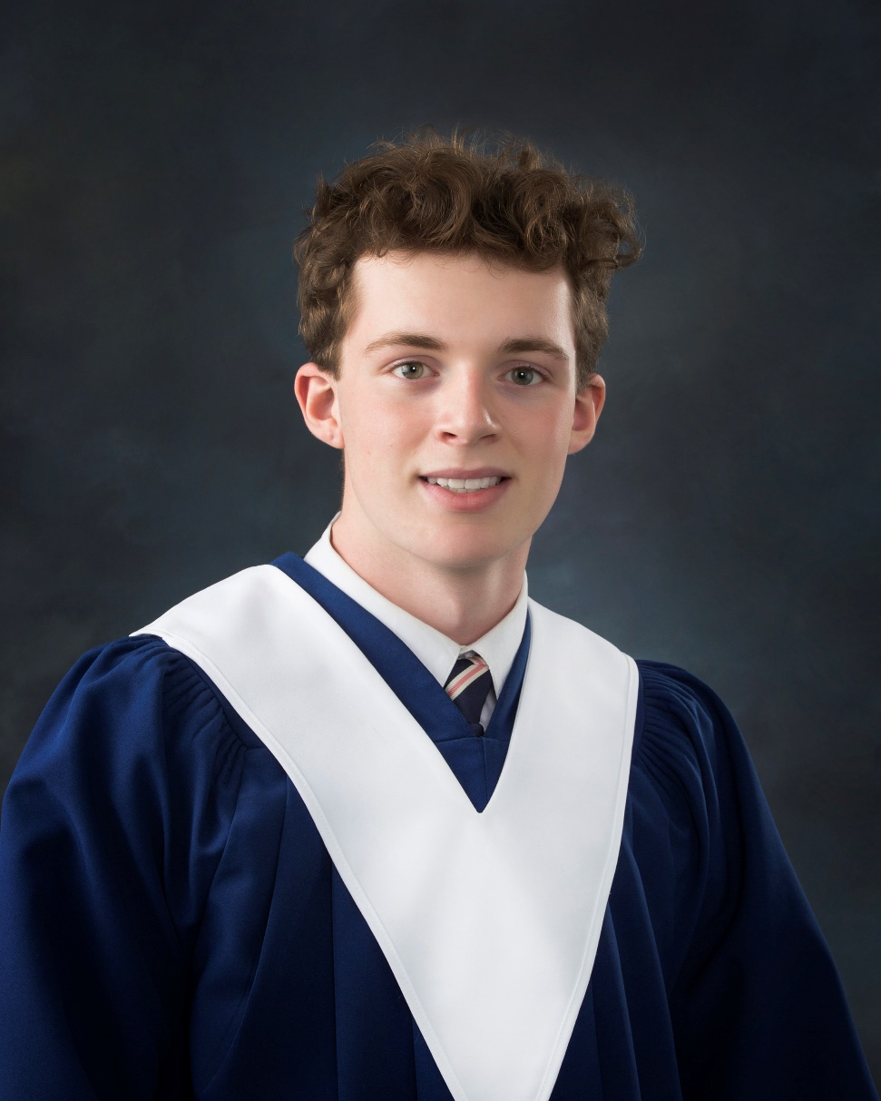
EMILY CULBERSON MEMORIAL AWARD DONATED BY FAMILY & FRIENDS
For a graduate who has demonstrated aptitude and interest in Science, has demonstrated integrity, good work ethic and who treats their peers with respect.
Isaac Jewett

Slide 29
FREDERICTON COMMUNITY FOUNDATION AWARD
For a worthy graduate who has studied music during all four years of high school.
Chantalle Levesque

Slide 30
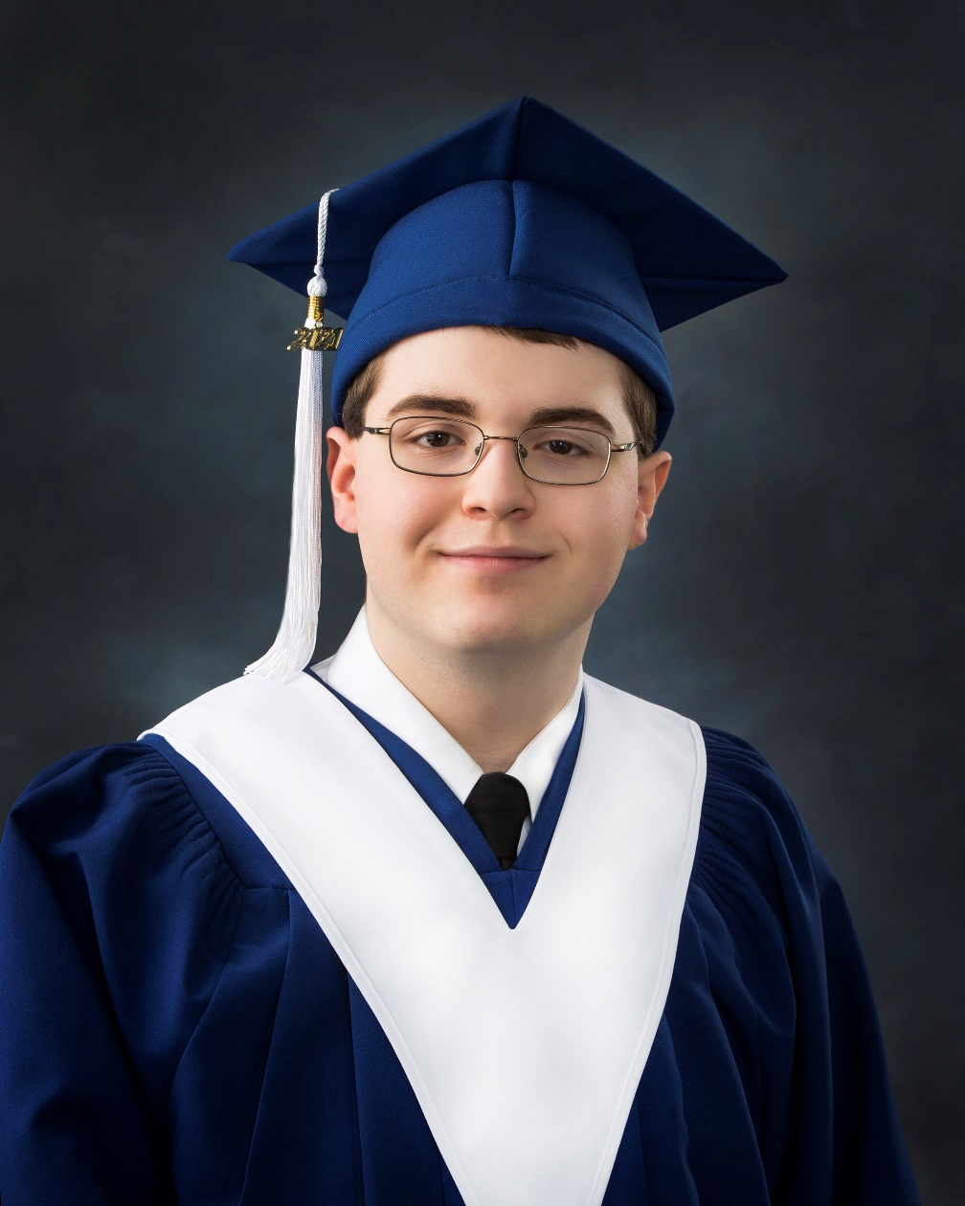
FREDERICTON GOLDEN CLUB PRIZE
For a deserving graduate who will be attending New Brunswick Community College, Business College, or Trade School in the fall.
Matthew Price

Slide 31
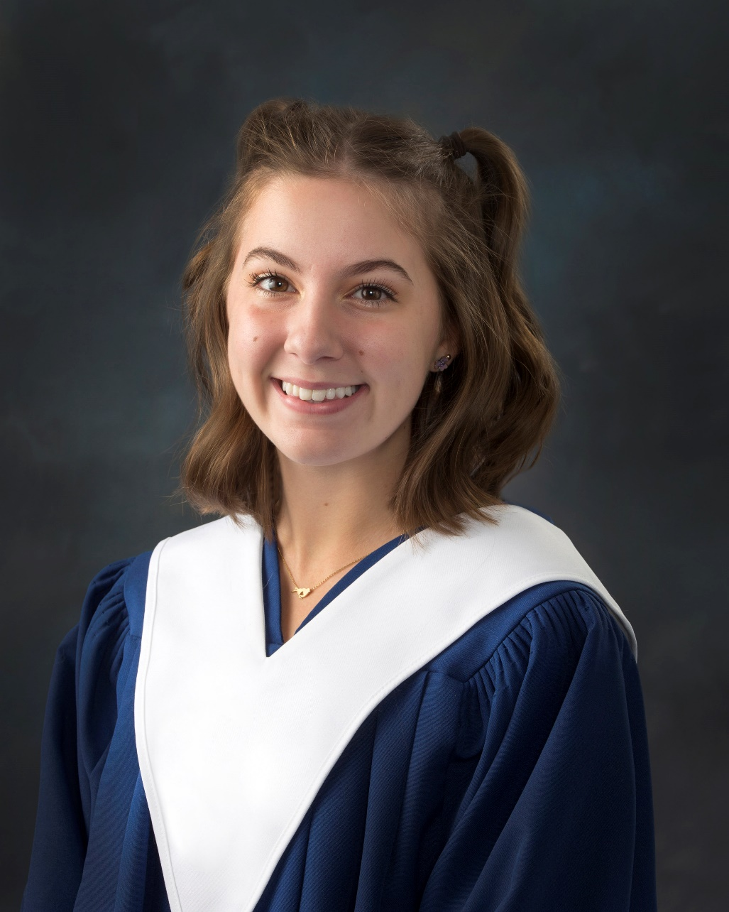
FREDERICTON GOLDEN CLUB PRIZE
For a deserving graduate who will be attending New Brunswick Community College, Business College, or Trade School in the fall.
Olivia Greenman

Slide 32
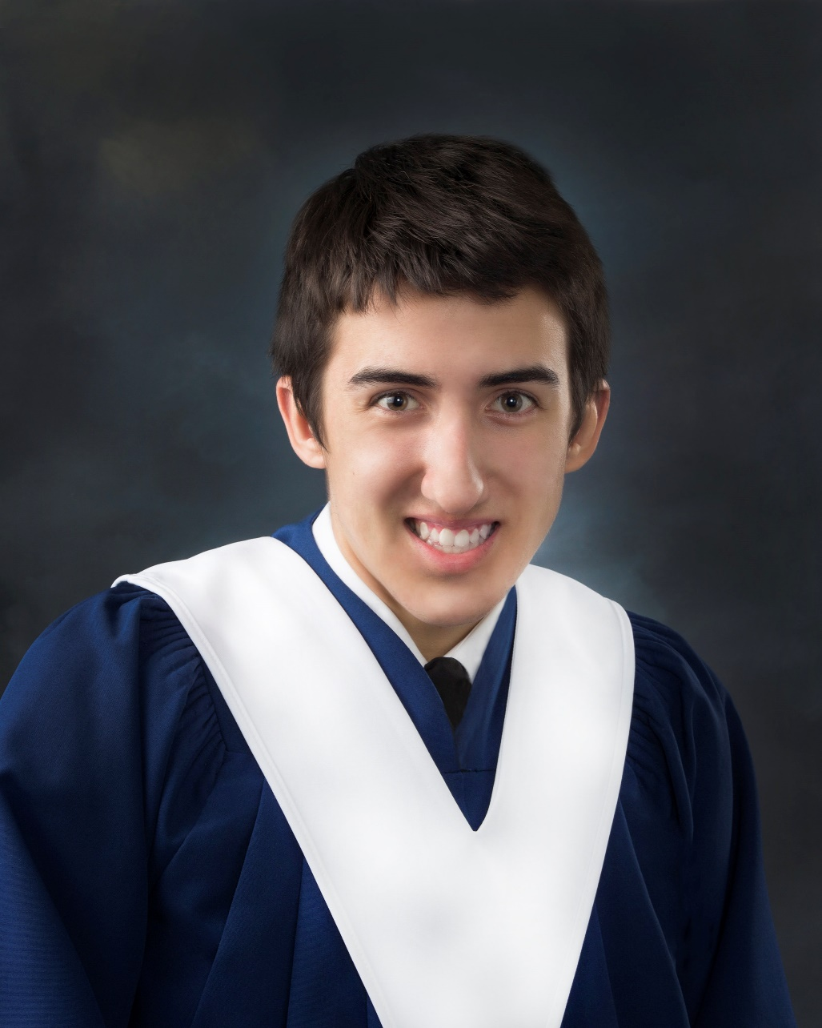
FREDERICTON NORTHWEST CONSTRUCTION
For a graduate who will be pursuing further education in the trades and/or carpentry.
Zachary Whalen

Slide 33
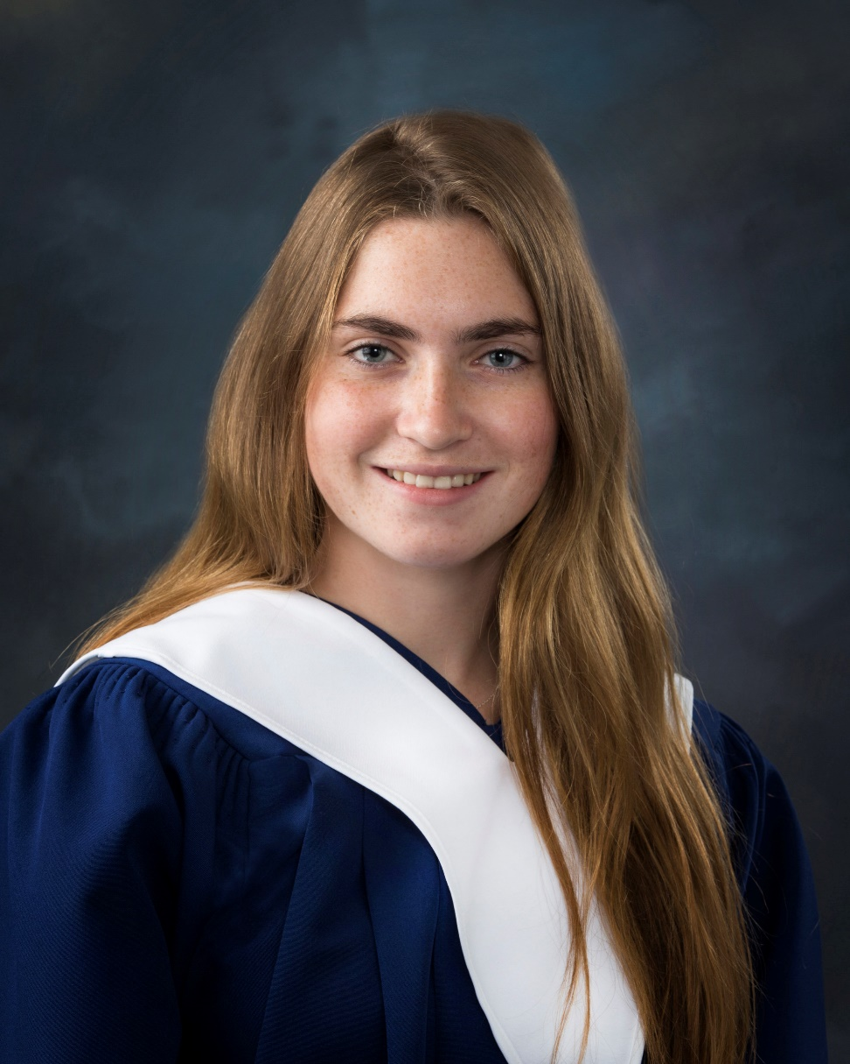
FREDERICTON NORTH ROTARY CLUB BURSARY
For a graduate with good academic standing whose average is 75% or above and who has demonstrated “service above self” and is involved in various school and community extra-curricular activities.
Emily Erin Lisa Day

Slide 34
FREDERICTON NORTH ROTARY CLUB BURSARY
For a graduate with good academic standing whose average is 75% or above and who has demonstrated “service above self” and is involved in various school and community extra-curricular activities.
Joy Shin

Slide 35
For a deserving graduate who has taken Business Organization and Management 120 and demonstrated the leadership ability to become an entrepreneur and business leader in the community.
GERALD T. SUTHERLAND MEMORIAL GRADUATION PRIZE
Sarah Marshall

Slide 36
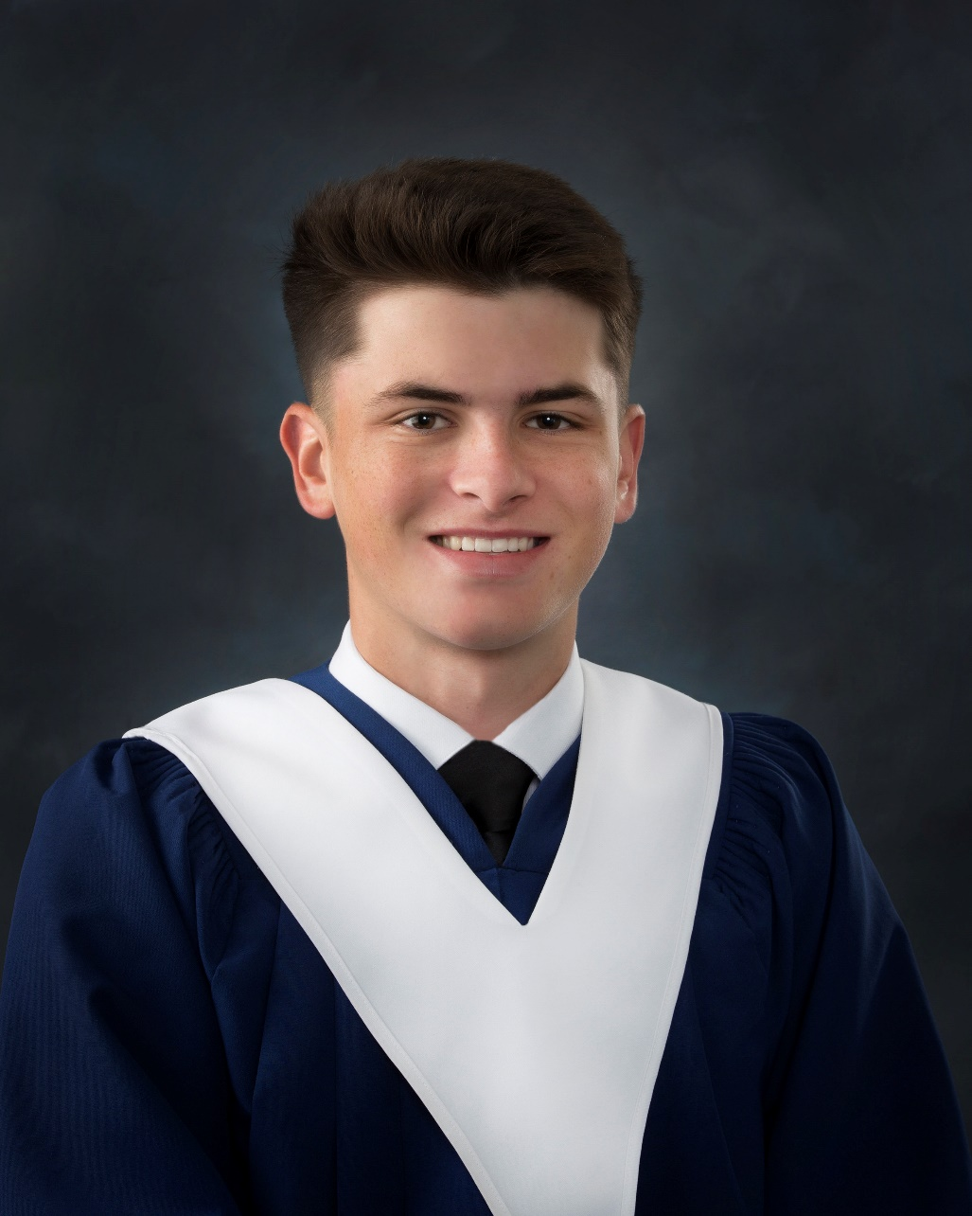
For a deserving graduate who has taken Entrepreneurship 120 and demonstrated the leadership ability to become an entrepreneur and business leader in the community.
GERALD T. SUTHERLAND MEMORIAL GRADUATION PRIZE
Cole MacTavish

Slide 37
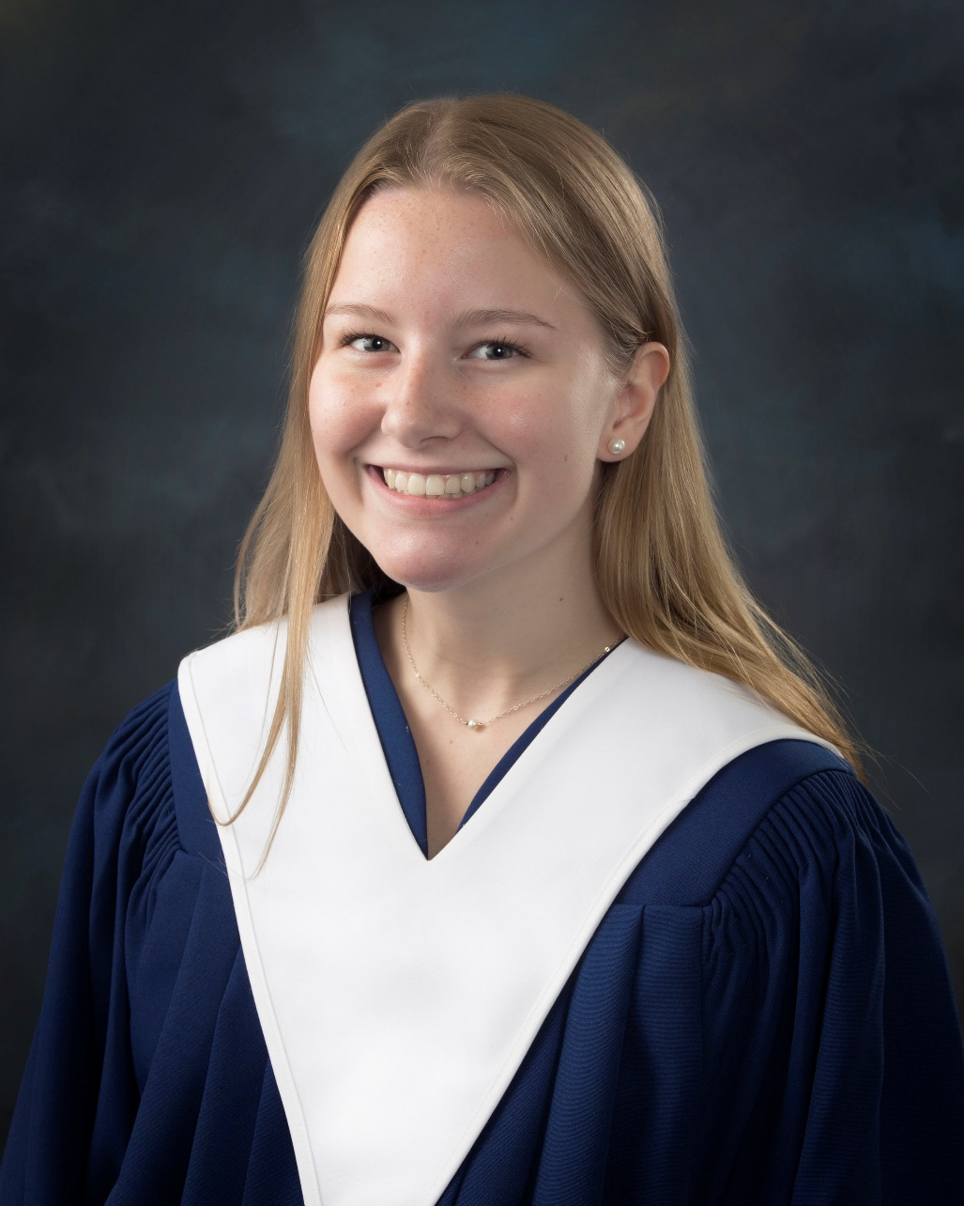
GERTRUDE DUFFIE AWARD IN ART
For a graduate who exhibits excellence in the Visual Arts at the grade 11 level.
Chloe Hanson

Slide 38
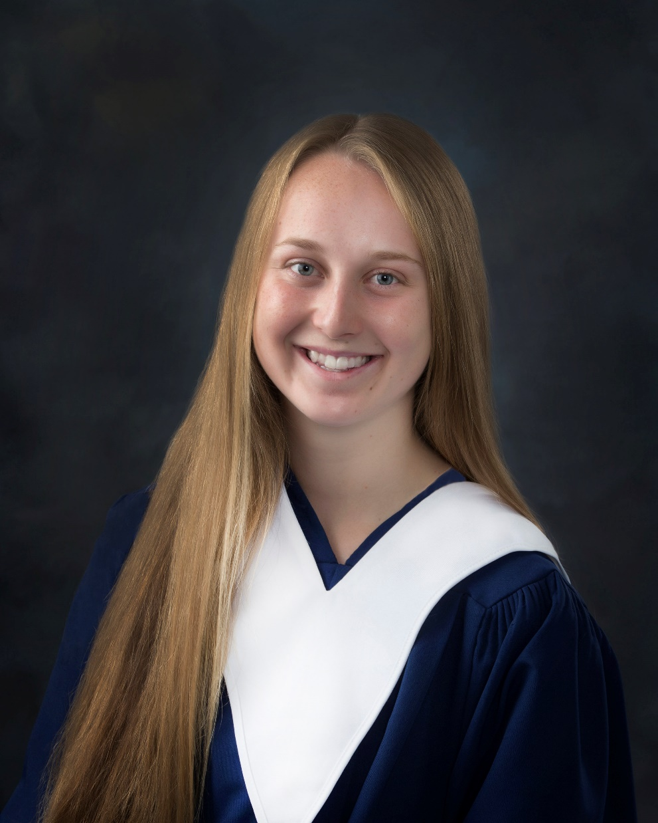
GERTRUDE DUFFIE AWARD IN ART
For a graduate who exhibits excellence in Visual Arts at the grade 12 level.
Rebekah Rich

Slide 39
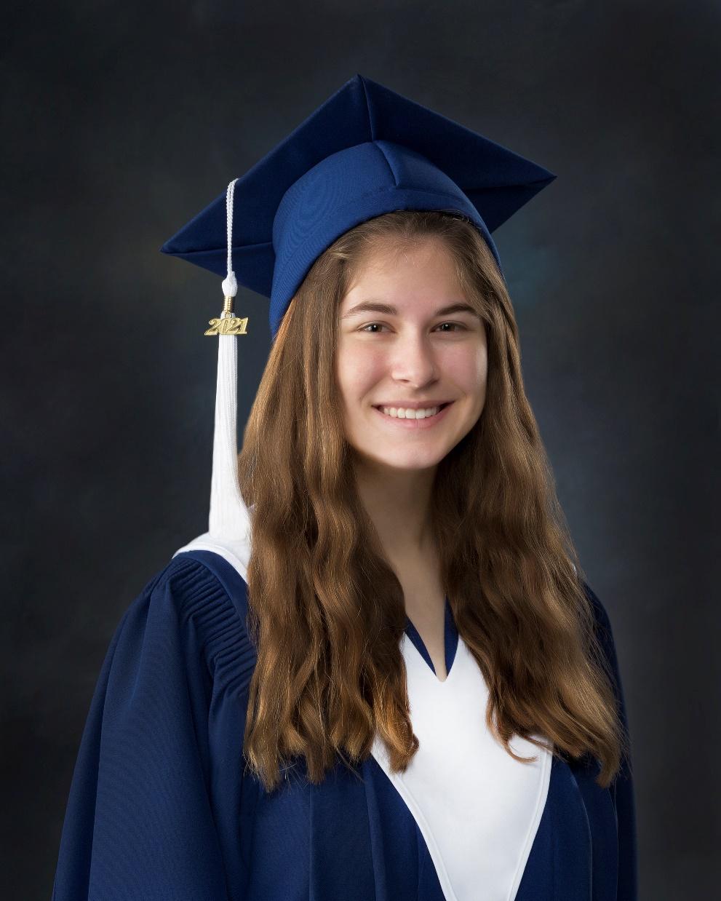
GDI INTEGRATED FACILITY SERVICES
Dahlia Zaat

Slide 40
GOVERNOR GENERAL’S
ACADEMIC MEDAL
For the graduating student with the highest aggregate of grade eleven and twelve courses.
Rakshit Galwa

Slide 41
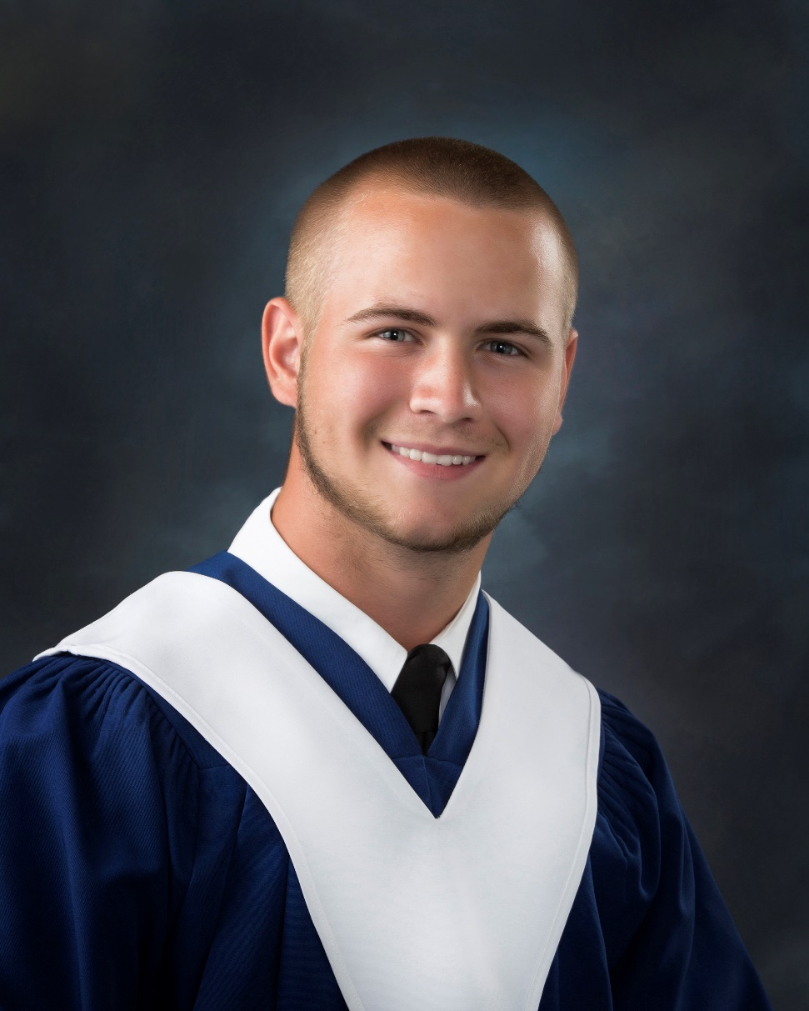
GRAHAM ORANGE LODGE VOCATIONAL BURSARY
For the top graduating vocational student.
Scott Dayton

Slide 42
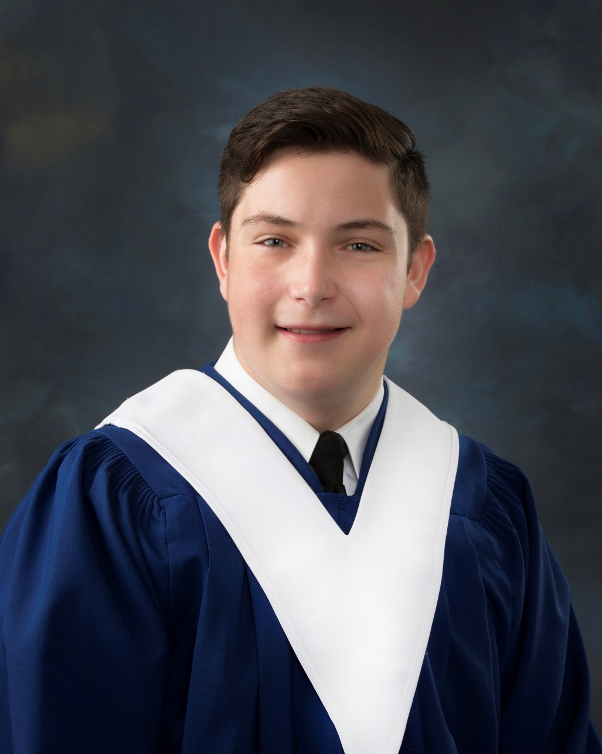
HARVEY STUDIOS PRIZE
For a graduate with an interest and aptitude in Media Studies.
Isaac Mathews

Slide 43
IN MEMORY OF ALLAN HUGHES THE UNSUNG HERO AWARD
For a graduate who is school and community minded and brings a sense of well-being to all who interact with them.
Ryan Wetmore

Slide 44
IN MEMORY OF ALLAN HUGHES THE PEACEKEEPER SCHOLARSHIP
For a graduate who is a peacemaker of sound character and an upstanding citizen of the school and community who is pursuing studies in the field of policing.
Isaac Mathews

Slide 45
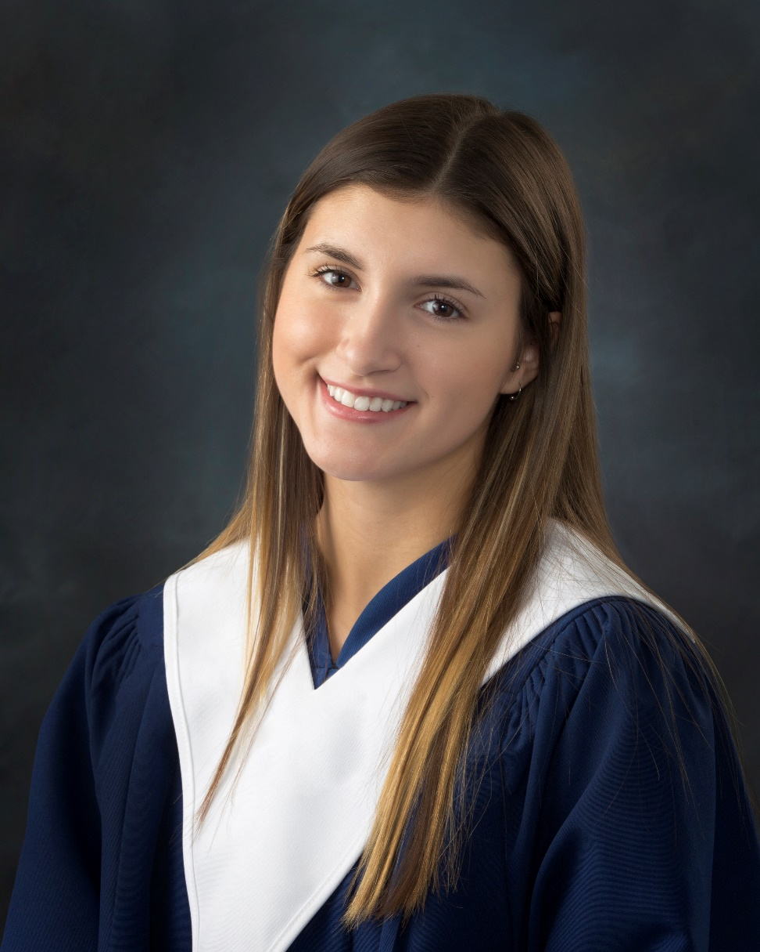
IODE SCHOLARSHIP THE DORIS E. SULLIVAN CHAPTER
For a deserving graduate that is pursuing a post-secondary program and is of good character and academic standing. This graduate exemplifies the principles of I.O.D.E. which are service volunteering and community mindedness.
Fallon Thornton

Slide 46
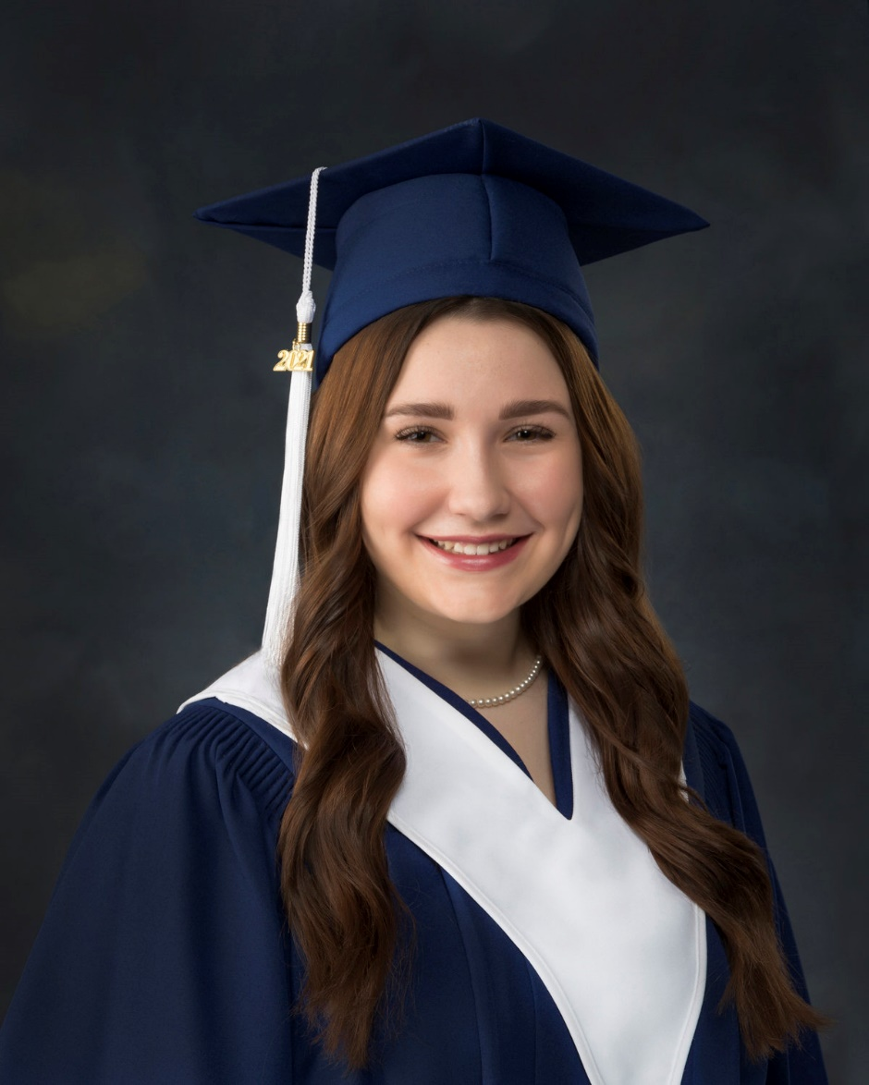
JOSTEN’S MEDALLIONS OF EXCELLENCE AND YEARBOOK LEADERSHIP AWARD
For each of the yearbook editors that have produced the 2021 LHHS Dream Catcher Yearbook.
Ella Wells

Slide 47
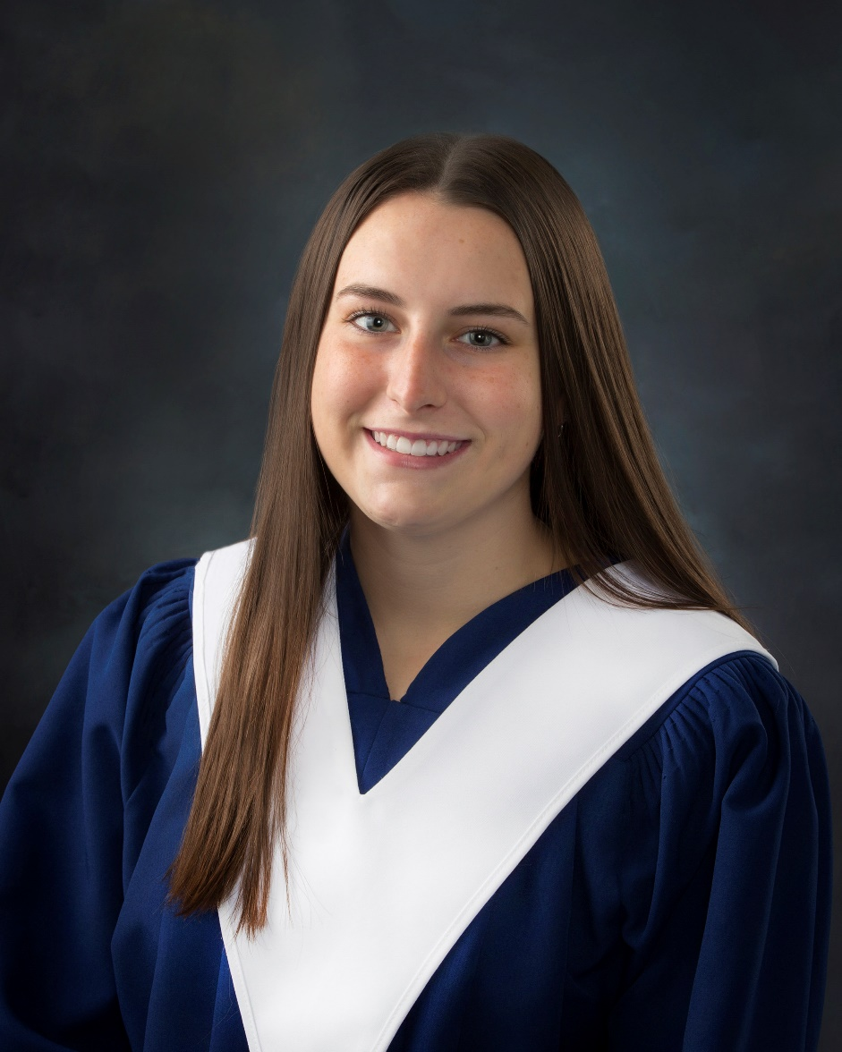
JOSTEN’S MEDALLIONS OF EXCELLENCE AND YEARBOOK LEADERSHIP AWARD
For each of the yearbook editors that have produced the 2021 LHHS Dream Catcher Yearbook.
Emma Russell

Slide 48
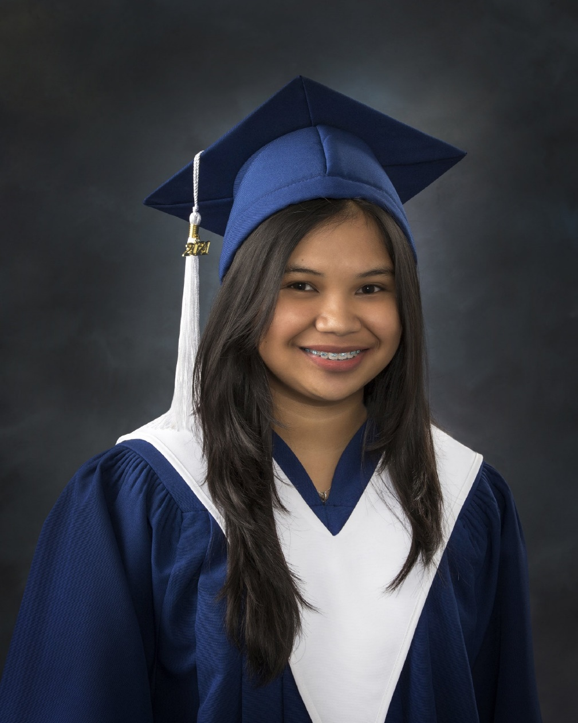
KIN CLUB OF NASHWAAKSIS PRIZE
For a graduate involved in community work and who will attend a post- secondary institute in the fall.
Jaylieca Chavez

Slide 49
KINGSWOOD TURNAROUND ACHIEVEMENT AWARD
In recognition of a student overcoming adversity through effort, commitment and perseverance and thus turning their life around.
Tyisha Davis

Slide 50
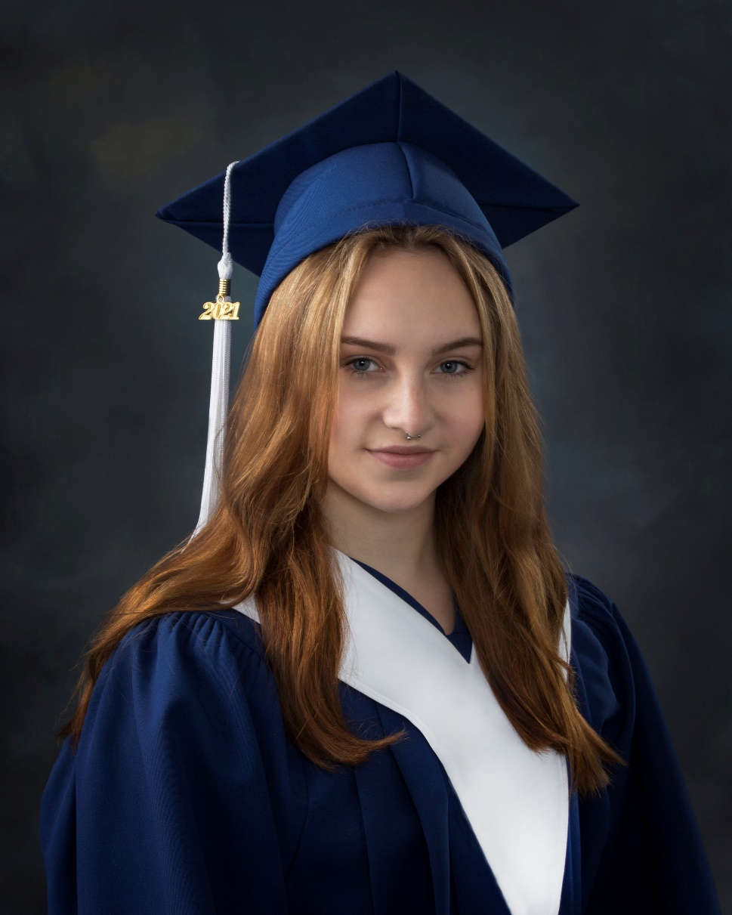
KINGSWOOD TURNAROUND ACHIEVEMENT AWARD
In recognition of a student overcoming adversity through effort, commitment and perseverance and thus turning their life around.
Emma McHatten

Slide 51
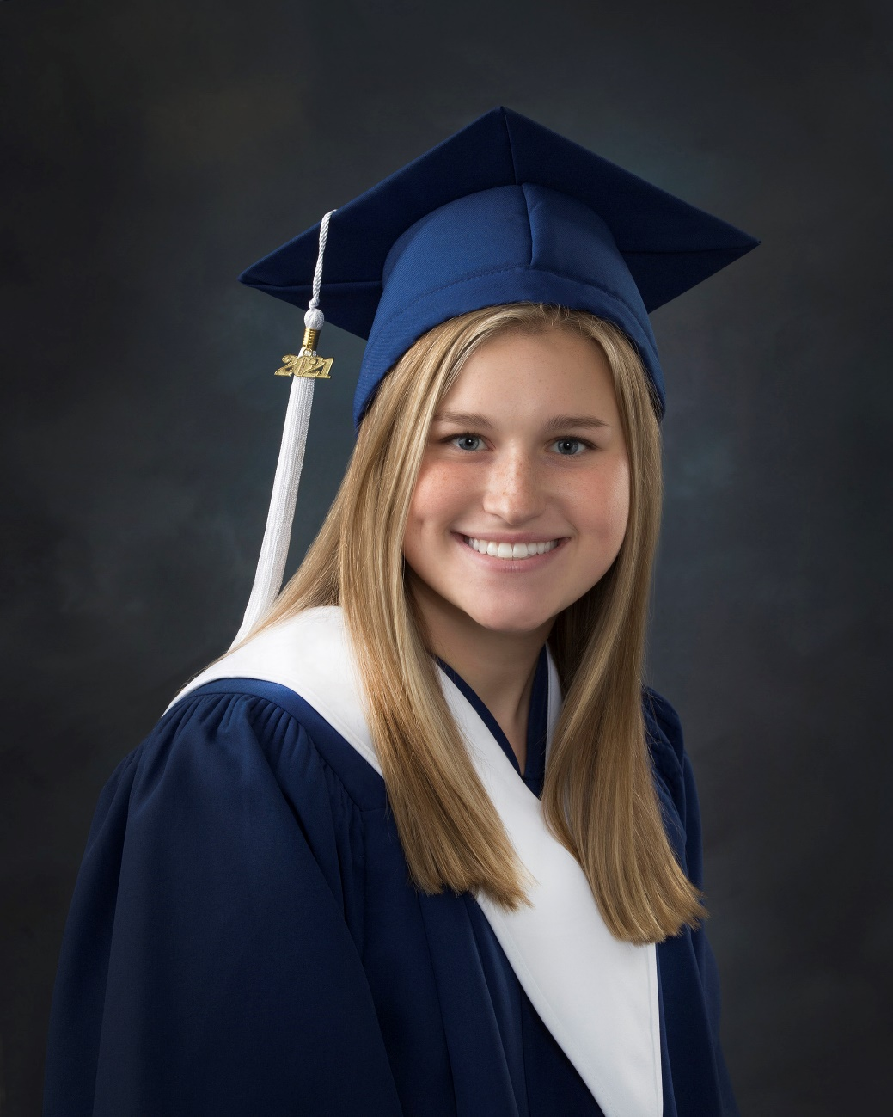
KIWANIS CLUB OF FREDERICTON PRIZE
For a graduate who has demonstrated sound academic achievement, made a significant contribution to school and community, and intends to pursue a post-secondary education in the fall.
Anna Lingley

Slide 52
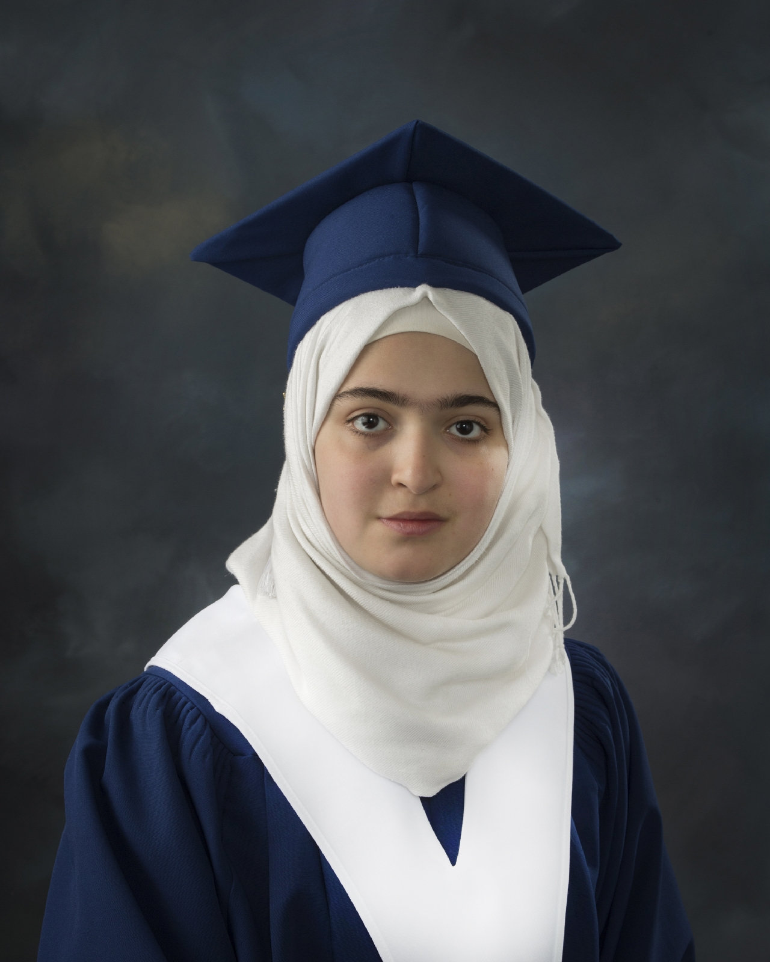
LHHS DIVERSITY CHAMPION AWARD
For a graduate who studied English as an Additional Language during their time at LHHS and who was actively involved in promoting and celebrating cultural diversity and inclusion/belonging at the school
Hala Bakhash

Slide 53
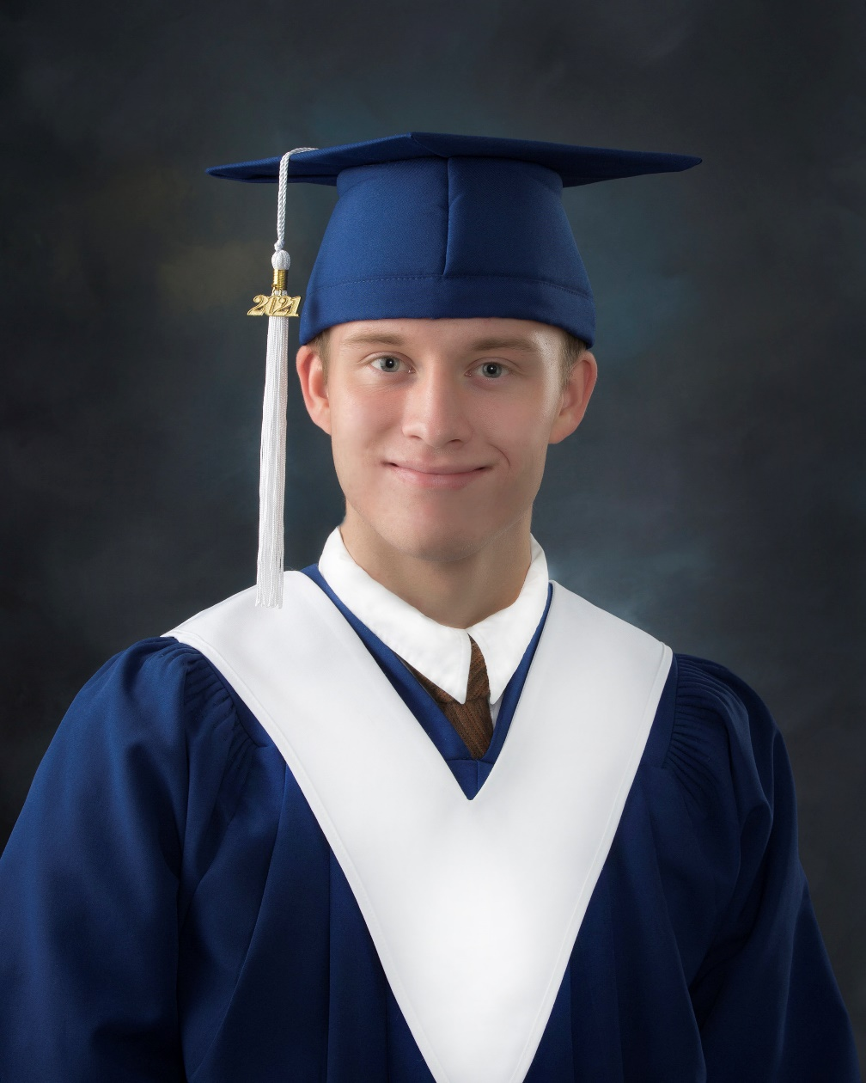
LHHS MUSIC SUPPORT GROUP PRIZE
For a graduate who has excelled at all aspects of music.
Gavin Woodward

Slide 54
LHHS MUSIC SUPPORT GROUP PRIZE
For a graduate with an interest and aptitude in Music.
Keaton Tapley

Slide 55
LHHS MUSIC SUPPORT GROUP PRIZE
For a graduate who exemplifies service to others in the music program.
Joy Shin

Slide 56
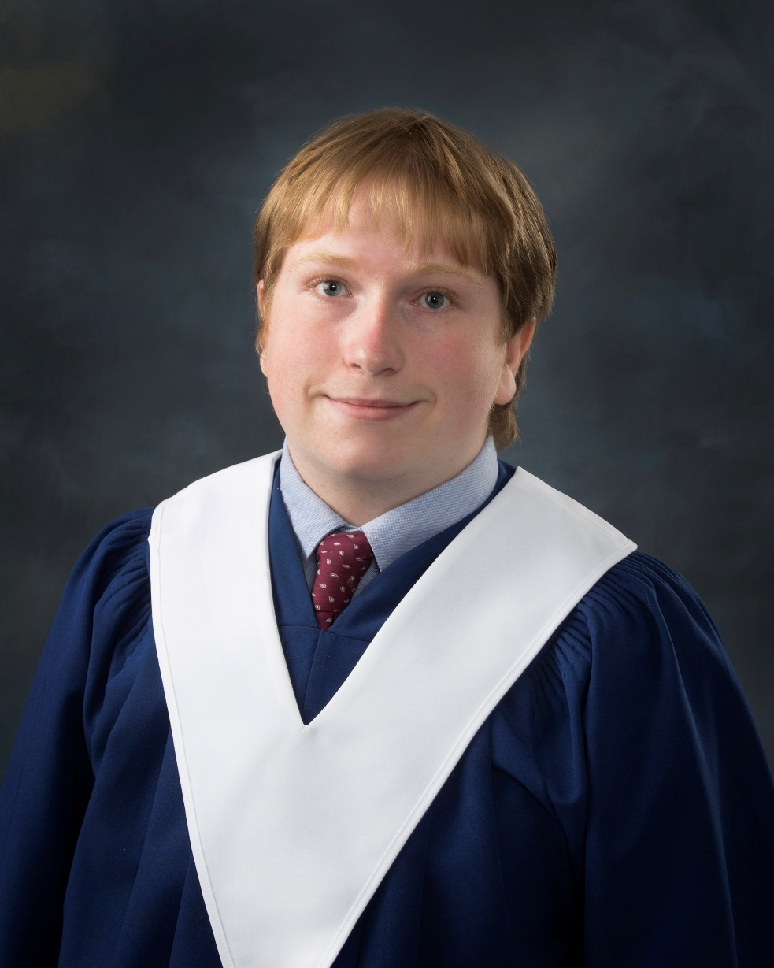
LHHS PRODUCTION AWARD
For a deserving graduate who has shown great commitment to production by actively being involved for three or four years.
Ryca McCullough

Slide 57
LHHS PRODUCTION AWARD
For a deserving graduate who has shown great commitment to production by actively being involved for three or four years.
Anna Lingley

Slide 58
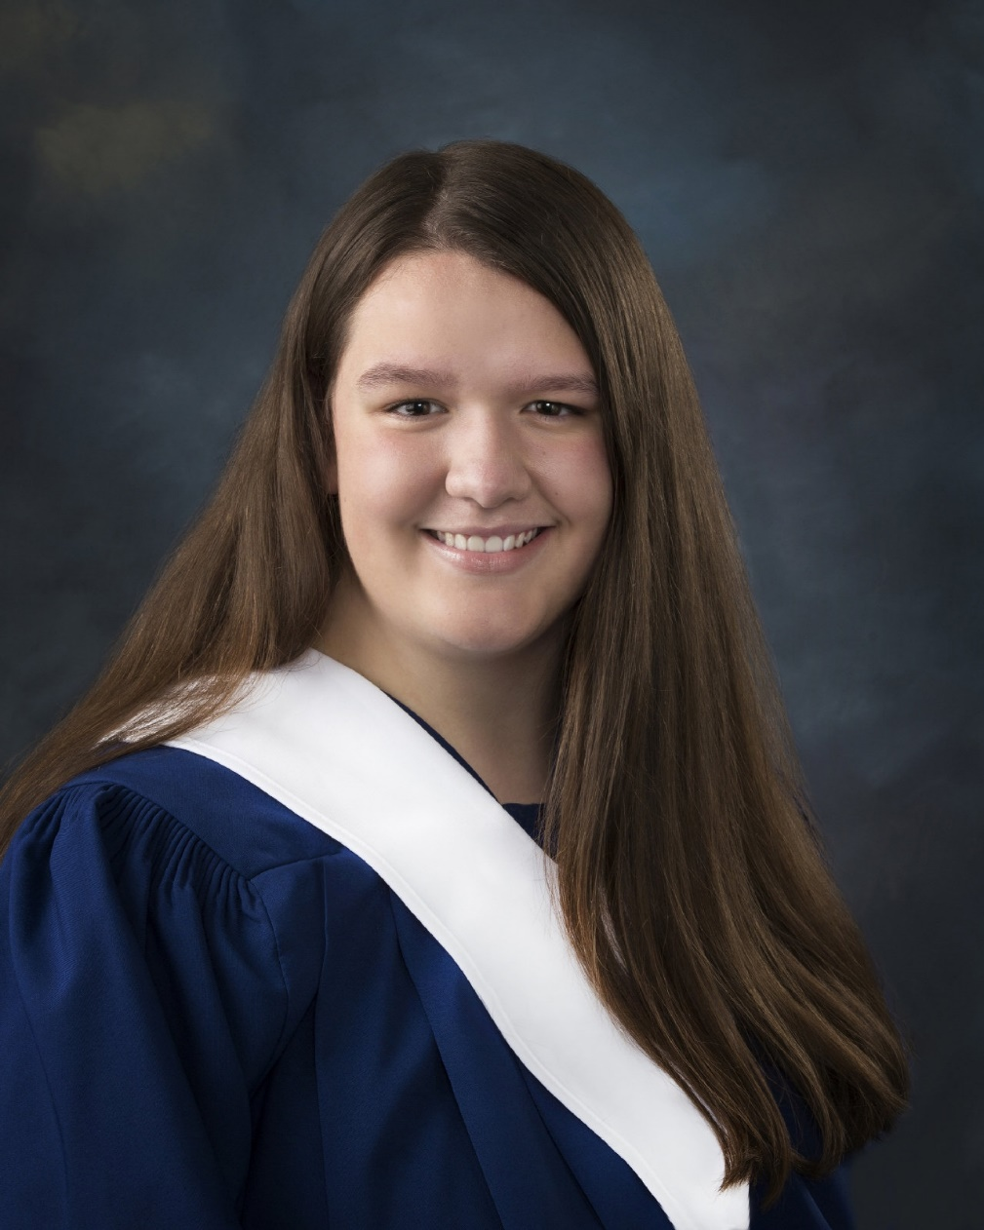
LHHS PRODUCTION AWARD
For a deserving graduate who has shown great commitment to production by actively being involved for three or four years.
Karlie Curtis

Slide 59
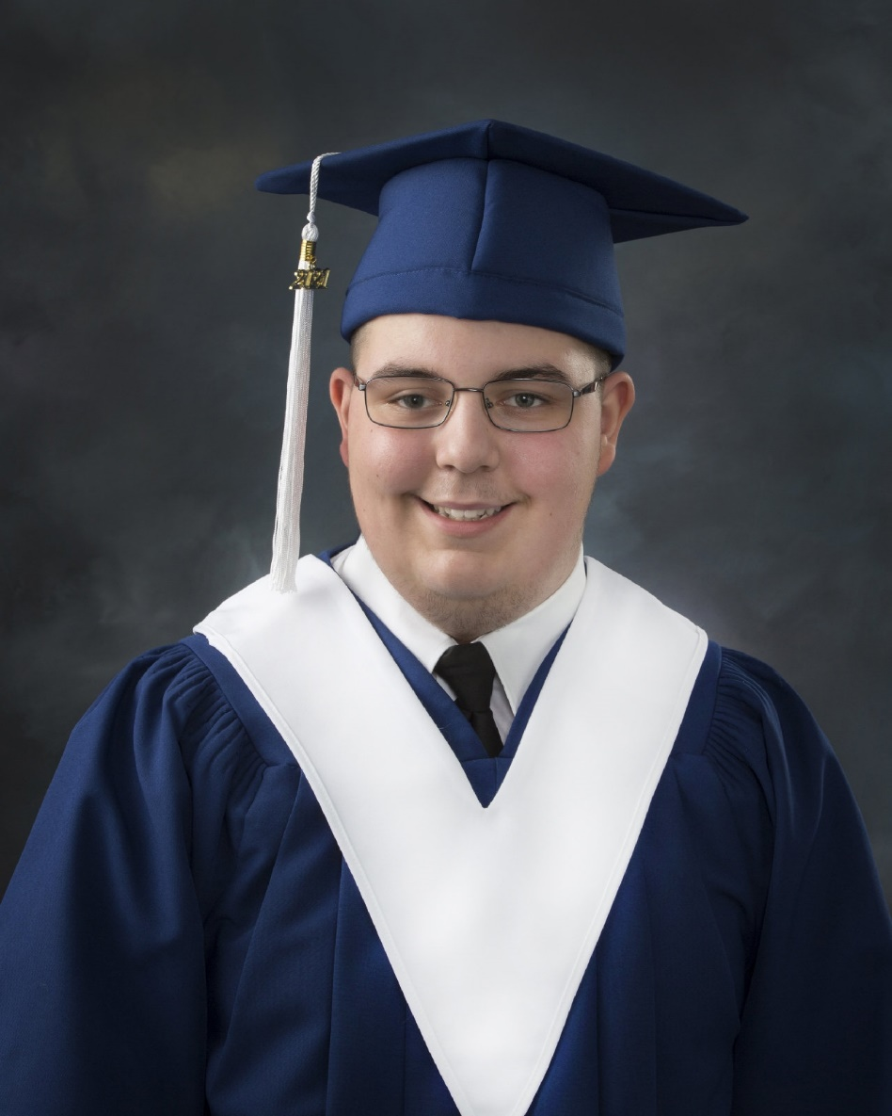
LHHS PRODUCTION AWARD
For a deserving graduate who has shown great commitment to production by actively being involved for three or four years.
Austin Anderson

Slide 60
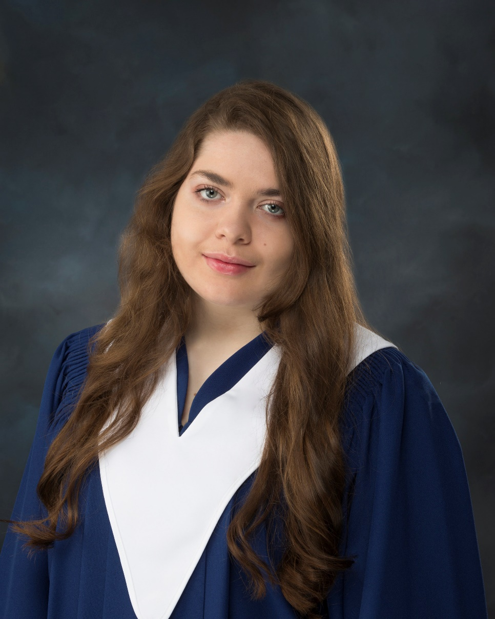
LHHS PRODUCTION AWARD
For a deserving graduate who has shown great commitment to production by actively being involved for three or four years.
Lauren Dugdale

Slide 61
LHHS RENAISSANCE
LEADERSHIP AWARD
For a graduate who has demonstrated outstanding leadership and commitment to the Renaissance Program.
Kaileigh Surrett

Slide 62
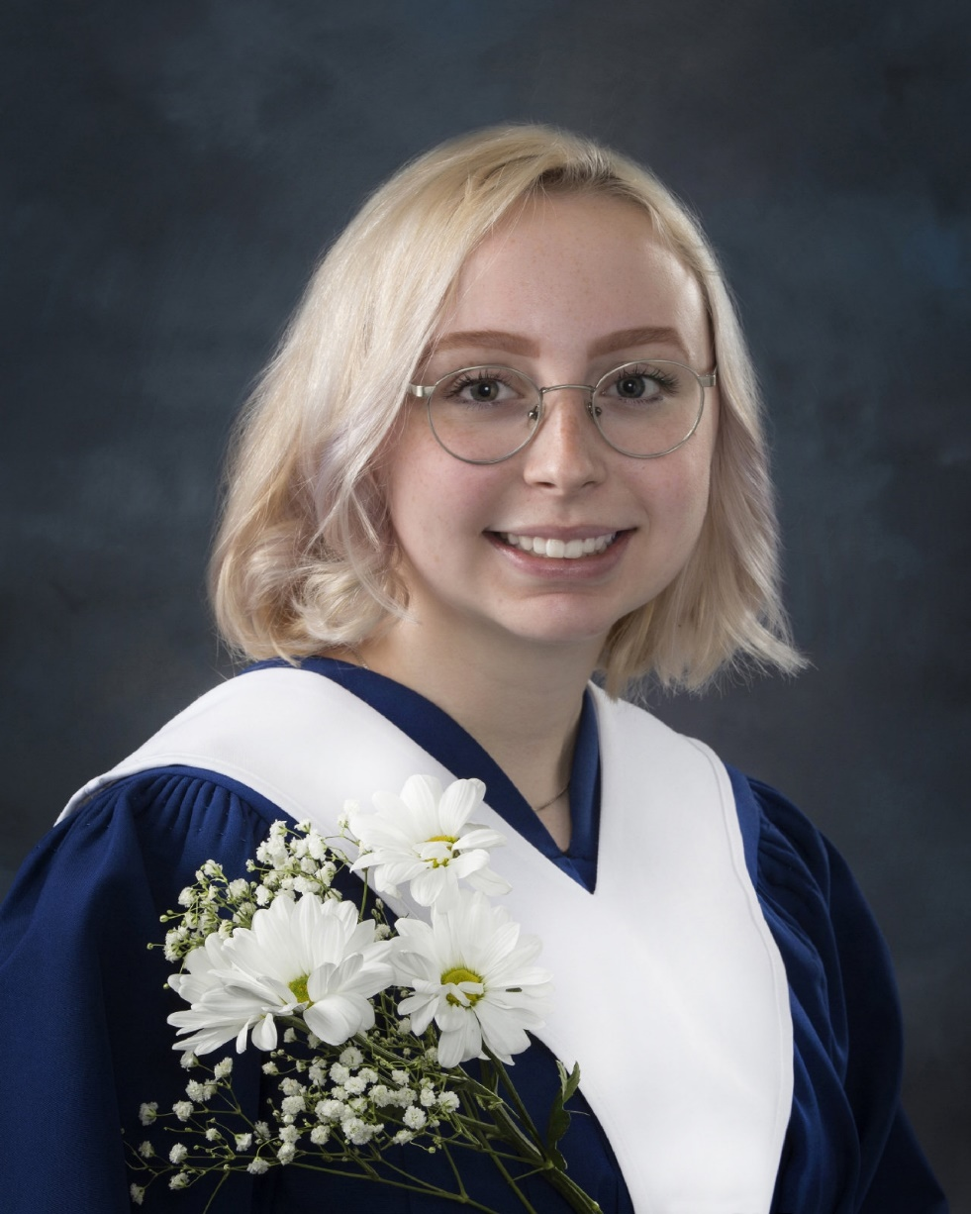
LHHS RENAISSANCE
LEADERSHIP AWARD
For a graduate who has demonstrated outstanding leadership and commitment to the Renaissance Program.
Olivia Brennan

Slide 63
LHHS RENAISSANCE
LEADERSHIP AWARD
For a graduate who has demonstrated outstanding leadership and commitment to the Renaissance Program.
Keaton Tapley

Slide 64
LHHS RENAISSANCE
LEADERSHIP AWARD
For a graduate who has demonstrated outstanding leadership and commitment to the Renaissance Program.
Nat Scott

Slide 65
LHHS RENAISSANCE
LEADERSHIP AWARD
For a graduate who has demonstrated outstanding leadership and commitment to the Renaissance Program.
Caitlyn Sinclair

Slide 66
LHHS RENAISSANCE
LEADERSHIP AWARD
For a graduate who has demonstrated outstanding leadership and commitment to the Renaissance Program.
Sam Hawkes

Slide 67
LHHS SAFE GRAD PRIZE
For a deserving graduate attending a post-secondary institution in the fall and who has been involved in Safe Grad events as well as extra-curricular activities.
Benjamin Durette

Slide 68
LHHS SAFE GRAD PRIZE
For a deserving graduate attending a post-secondary institution in the fall and who has been involved in Safe Grad events as well as extra-curricular activities.
Samuel Hawkes

Slide 69
LHHS SAFE GRAD PRIZE
For a deserving graduate attending a post-secondary institution in the fall and who has been involved in Safe Grad events as well as extra-curricular activities.
Natalie Irving

Slide 70
LHHS SAFE GRAD PRIZE
For a deserving graduate attending a post-secondary institution in the fall and who has been involved in Safe Grad events as well as extra-curricular activities.
Rebekah Kierstead

Slide 71
LHHS SAFE GRAD PRIZE
For a deserving graduate attending a post-secondary institution in the fall and who has been involved in Safe Grad events as well as extra-curricular activities.
Anna Lingley

Slide 72
LHHS SAFE GRAD PRIZE
For a deserving graduate attending a post-secondary institution in the fall and who has been involved in Safe Grad events as well as extra-curricular activities.
Melanie Morehouse

Slide 73
LHHS SAFE GRAD PRIZE
For a deserving graduate attending a post-secondary institution in the fall and who has been involved in Safe Grad events as well as extra-curricular activities.
Jason Smith

Slide 74
LHHS SAFE GRAD PRIZE
For a deserving graduate attending a post-secondary institution in the fall and who has been involved in Safe Grad events as well as extra-curricular activities.
Ella Ramier

Slide 75
LHHS SAFE GRAD PRIZE
For a deserving graduate attending a post-secondary institution in the fall and who has been involved in Safe Grad events as well as extra-curricular activities.
Rebekah Rich

Slide 76
LHHS SAFE GRAD PRIZE
For a deserving graduate attending a post-secondary institution in the fall and who has been involved in Safe Grad events as well as extra-curricular activities.
Andrew Kroon

Slide 77
LHHS SECOND LANGUAGE DEPARTMENT AWARD
For a graduate who has demonstrated a passion and interest in learning French as a second language.
Jason Smith

Slide 78
LHHS SECOND LANGUAGE DEPARTMENT AWARD
For a graduate who has demonstrated a passion and interest in learning French as a second language.
Brandon Fox

Slide 79
LHHS STAFF PRIZE
For a graduate with an interest and aptitude in Digital Production.
Elena Kurilova

Slide 80
For a deserving graduate who has shown considerable growth through goal setting, hard work and perseverance. This student accepted the challenge of self and academic improvement and worked hard to achieve both personal and academic goals and experienced success with both.
LHHS STAFF PRIZE
Liam MacKinnon

Slide 81
LHHS STAFF PRIZE
For a graduate who has overcome extreme adversity and who is pursuing university studies.
Natasha Allain

Slide 82
LHHS STAFF PRIZE
For a graduate with a passionate interest in English Language Arts.
Caitlyn Sinclair

Slide 83
LHHS STAFF PRIZE
For a graduate with a passionate interest in the learning of Mathematics.
Jason Smith

Slide 84
LHHS STAFF PRIZE
For a well-rounded graduate who goes above and beyond in a variety of scholastic and extra-curricular activities.
Emily Erin Lisa Day

Slide 85
LHHS STAFF PRIZE
For a graduate who demonstrated resilience in successfully adapting to and engaging in online learning opportunities
Delaney Smallwood

Slide 86
LHHS STAFF PRIZE
For a graduate with a keen interest in the social sciences throughout high school.
Ellie Weir

Slide 87
LHHS STAFF PRIZE
For a graduate with a keen interest and aptitude in the skilled trades.
Faith Knox

Slide 88
LHHS STAFF PRIZE
For a graduate who regularly demonstrates service above self to students and staff.
Fallon Thornton

Slide 89
LHHS VISUAL ARTS AWARD
For a graduate pursuing post-secondary studies in Visual Arts and who was involved in various Art activities at Leo Hayes.
Rebekah Rich

Slide 90
LHHS VISUAL ARTS AWARD
For a graduate who completed all levels of Visual Arts with high standing and was involved in various activities in the Visual Arts at Leo Hayes.
Kaileigh Surrett

Slide 91
LORETTA HAYES NURSING AWARD
For a deserving graduate pursuing a career in Nursing.
Natalie Irving

Slide 92
MARY ELLEN NEALIS PHOTOGRAPHY PRIZE
For a graduate with high academic standing and involvement in the Arts.
Chantalle Levesque

Slide 93
MARY ELLEN NEALIS PHOTOGRAPHY PRIZE
For a graduate with high academic standing and involvement in the Arts.
Isabella Doherty

Slide 94
MICHAEL BALDWIN
MEMORIAL AWARD
For a deserving graduate who exemplifies the motto of the Best Buddies Program, “making a difference one friendship at a time.”
Sydney Nason

Slide 95
MIKE FITZGERALD BASKETBALL BURSARY
Awarded to a graduating varsity basketball player who has achieved acceptable academic standing and demonstrated the following personal characteristics: a passion for the game of basketball; a sustained commitment to improving as a player; a player with tenacity and drive – “Leaves it all on the court”; a leader on the court and in the locker room.
Madalynn Kean

Slide 96
MIKE FITZGERALD BASKETBALL BURSARY
Awarded to a graduating varsity basketball player who has achieved acceptable academic standing and demonstrated the following personal characteristics: a passion for the game of basketball; a sustained commitment to improving as a player; a player with tenacity and drive – “Leaves all on the court”; a leader on the court and in the locker room.
Jaron Killam

Slide 97
MIKE FITZGERALD MEMORIAL SCHOLARSHIP
For a deserving graduate with an average of 80% or higher who played on a basketball team and will be pursuing a university education.
Tyler Green

Slide 98
MONTEITH FAMILY PRIZE IN MEMORY OF THE MONTEITH FAMILY OF ST. MARY’S ST.
For a graduate with a high standing in Modern History.
Jenna Campbell

Slide 99
MORNEAU SHEPELL AWARD
For a graduate who has shown a keen interest in mathematics throughout high school by excelling in advanced courses and mathematics contests.
Rakshit Galwa

Slide 100
MURRAY SARGENT
Ella Ramier

Slide 101
NASHWAAKSIS LIONS CLUB BURSARY
For a deserving graduate who will pursue a post-secondary education.
Nat Scott

Slide 102
NASHWAAKSIS LIONS CLUB BURSARY
For a deserving graduate who will pursue a post-secondary education.
Rakshit Galwa

Slide 103
2021 CANADA WIDE SCIENCE FAIR COMPETITOR & BRONZE EXCELLENCE AWARD
Project: Impacts of Climate Change-Induced Seawater Inundation on an Agriculturally Important Soil Bacterium
Rakshit Galwa

Slide 104
NBSRT RETIRED TEACHERS QUILTERS GROUP
For a deserving graduate who is a responsible and diligent student that will be furthering their education.
Anthony Durette

Slide 105
NBSRT RETIRED TEACHERS QUILTERS GROUP
For a deserving graduate who is a responsible and diligent student that will be furthering their education.
Rebekah Kierstead

Slide 106
NBSRT RETIRED TEACHERS QUILTERS GROUP
For a deserving graduate who is a responsible and diligent student that will be furthering their education.
Sophia Crowther

Slide 107
NBTA BRANCH 1826 AWARD
For a deserving graduate who is the son or daughter of a statutory or casual member of NBTA Branch 1826.
Katelyn Stewart

Slide 108
NELSON CAPSON EXCELLENCE IN THE TRADES AWARD
For a graduate who has demonstrated excellence in completion of trades courses and plans to pursue a university education.
Isaac Jewett

Slide 109
NEW BRUNSWICK BRAIN BEE CHAMPION
Rakshit Galwa

Slide 110
NEW BRUNSWICK PUBLIC COLLEGES ENTRANCE SCHOLARSHIP
For a deserving graduate who will be attending NBCC in the fall.
Madelyn Pollard

Slide 111
PRINCIPAL’S AWARD
For a graduate who has contributed selflessly to the school and has demonstrated great leadership.
Karlie Curtis

Slide 112
PRINCIPAL’S LEADERSHIP AWARD
For a student with high academic standing and leadership in student activities.
Benjamin Durette

Slide 113
PROGRESSIVE CREDIT UNION PRIZE
For a graduate who displays an entrepreneurial spirit.
Lucy Armstrong

Slide 114
PROGRESSIVE CREDIT UNION PRIZE
For a graduate with interest in developing their French language proficiency.
Simone Kitching

Slide 115
REG BONNELL MEMORIAL AWARD
For a deserving graduate who has been involved with both the athletic program and the fine arts program during their years at LHHS.
Caitlyn Sinclair

Slide 116
ST. MARY’S FIRST NATION ACHIEVEMENT AWARD
For the St. Mary’s First Nation graduate with the highest overall GPA.
Jayden Andreola

Slide 117
SCOTIA LEARNING CENTRES INC. AND COMPASS GROUP PRIZE
Benjamin Durette

Slide 118
SECOND CHANCES MUSIC AWARD, IN MEMORY OF CHRIS FIDLER
Personifying Second Chances Concert Band Fredericton, this prize is awarded to a Leo Hayes High School band member who is enthusiastic, demonstrates and optimistic outlook, is dedicated to the band and supportive of its members and recognizes the positive influence of music can help you to build community.
Marley Waugh

Slide 119
SKICINUWI-KCICIHTOMUWAKON AWARD
For a graduate who displayed excellence in Wabanaki Art.
Emily English

Slide 120
SKICINUWI-KCICIHTOMUWAKON AWARD
For a graduate who displayed excellence in Wabanaki Art.
Ky-Lynn Paul

Slide 121
SKICINUWI-KCICIHTOMUWAKON AWARD
For a graduate who displayed excellence in Wolastoqey Art and History.
Jeremiah Griffiths

Slide 122
SKICINUWI-KCICIHTOMUWAKON AWARD
For a graduate who displayed excellence in Wolastoqey Art and History.
Sierra Connor

Slide 123
SKICINUWI-KCICIHTOMUWAKON AWARD
For a graduate who displayed excellence in Wolastoqey Art and History.
Taylor Markey

Slide 124
SKICINUWI-KCICIHTOMUWAKON AWARD
For a graduate who displayed excellence in Wabanaki Studies.
Deseria Brooks

Slide 125
SKICINUWI-KCICIHTOMUWAKON AWARD
For a graduate who displayed excellence in Wabanaki Studies.
Thomas Neid Blenkin

Slide 126
SKICINUWI-KCICIHTOMUWAKON AWARD
For a graduate who has studies in Wabanaki Art, History and Language.
Kyler Paul

Slide 127
SKICINUWI-KCICIHTOMUWAKON AWARD
For a graduate who has studies in Wabanaki Art, History and Language.
Ethan LaBillois

Slide 128
SKICINUWI-KCICIHTOMUWAKON AWARD
For a graduate who has studies in Wabanaki Art, History and Language.
Marissa Paul

Slide 129
THE CANADIAN FEDERATION OF UNIVERSITY WOMEN, FREDERICTON SCHOLARSHIP
For a deserving female graduate who has demonstrated academic achievement and is pursuing post-secondary studies.
Rama Alturk

Slide 130
THE MURRAY & SHIRLEY BAILEY SCHOLARSHIP
For a deserving graduate who attended Keswick Valley School for at least three years and is pursuing post-secondary education.
Bailey Ira Brewer

Slide 131
UNBF FACULTY OF
EDUCATION PRIZE
For a graduate who is a Peer Mentor and who has shown to be a true role model for the students he/she has worked with this year, and will be attending the University of New Brunswick in Fredericton.
Andrew Kroon

Slide 132
UNB PHYSICS DEPARTMENT PRIZE
For a graduate who has shown an outstanding interest in Physics.
Lucas Porter

Slide 133
ST. THOMAS UNIVERSITY
York Funeral Home Scholarship
Madelyn Boyle

Slide 134
ST. THOMAS UNIVERSITY
Scholars Award
Brianna Burns

Slide 135
ST. THOMAS UNIVERSITY
Frank McKenna Scholarship
Karlie Curtis

Slide 136
ST. THOMAS UNIVERSITY
Scholars Award
Chantalle Levesque

Slide 137
ST. THOMAS UNIVERSITY
Monsignor Donald C. Duffie Memorial Scholarship
Isaac Mathews

Slide 138
ST. THOMAS UNIVERSITY
Judge J. Thomas Troy Memorial Scholarship
Nicholas Smith

Slide 139
ST. THOMAS UNIVERSITY
Achievement Award
Abigail Stickles

Slide 140
ST. THOMAS UNIVERSITY
The Dawn Russell Scholarship
Ellie Weir

Slide 141
ST. THOMAS UNIVERSITY
The Msgr. George W. Martin Scholarship
Gavin Woodword

Slide 142
UNIVERSITY OF NEW BRUNSWICK
Governor Thomas Carleton Scholarship
Lucy Armstrong

Slide 143
UNIVERSITY OF NEW BRUNSWICK
William and Lois Paine Founder’s Scholarship
Alia Bastin

Slide 144
UNIVERSITY OF NEW BRUNSWICK
William and Lois Paine Founder’s Scholarship
Summer Belliveau

Slide 145
UNIVERSITY OF NEW BRUNSWICK
Whitman Haines Memorial Scholarship
Isabel Bicknell

Slide 146
UNIVERSITY OF NEW BRUNSWICK
Governor Thomas Carleton Scholarship
Zachery Bishop

Slide 147
UNIVERSITY OF NEW BRUNSWICK
Governor Thomas Carleton Scholarship
Madelyn Boyle

Slide 148
UNIVERSITY OF NEW BRUNSWICK
Ward Chipman Founder’s Scholarship
Samuel Bubar

Slide 149
UNIVERSITY OF NEW BRUNSWICK
Edwin Jacob Special University Scholarship
Jenna Campbell

Slide 150
UNIVERSITY OF NEW BRUNSWICK
Edwin Jacob Special University Scholarship
Jaylieca Chavez

Slide 151
UNIVERSITY OF NEW BRUNSWICK
Mary Ann Thomas Scholarship in Nursing
Jaylieca Chavez

Slide 152
UNIVERSITY OF NEW BRUNSWICK
Thomas Family Scholarship
Yudam (Julia) Choi

Slide 153
UNIVERSITY OF NEW BRUNSWICK
William and Lois Paine Founder’s Scholarship
Scott Dayton

Slide 154
UNIVERSITY OF NEW BRUNSWICK
William and Lois Paine Founder’s Scholarship
Grace Doucett

Slide 155
UNIVERSITY OF NEW BRUNSWICK
William and Lois Paine Founder’s Scholarship
Olivia Dunn

Slide 156
UNIVERSITY OF NEW BRUNSWICK
J.D. Irving NB Leadership Scholarship
Benjamin Durette

Slide 157
UNIVERSITY OF NEW BRUNSWICK
Eldon and Maxine Clair Faculty of Computer Science Scholars
Anthony Durette

Slide 158
UNIVERSITY OF NEW BRUNSWICK
MacLauchlan McKenzie Scholarship in Computer Science
Anthony Durette

Slide 159
UNIVERSITY OF NEW BRUNSWICK
New Brunswick Students Scholarships UNBF
Madison Ebbett

Slide 160
UNIVERSITY OF NEW BRUNSWICK
Edwin Jacob Special University Scholarship
Madison Ebbett

Slide 161
UNIVERSITY OF NEW BRUNSWICK
William and Lois Paine Founder’s Scholarship
Salma ElSaid

Slide 162
UNIVERSITY OF NEW BRUNSWICK
William and Lois Paine Founder’s Scholarship
William Englehart

Slide 163
UNIVERSITY OF NEW BRUNSWICK
William and Lois Paine Founder’s Scholarship
Braden Galbraith

Slide 164
UNIVERSITY OF NEW BRUNSWICK
Governor Thomas Carleton Scholarship
Sarah Etheridge

Slide 165
UNIVERSITY OF NEW BRUNSWICK
William and Lois Paine Founder’s Scholarship
Rakshit Galwa

Slide 166
UNIVERSITY OF NEW BRUNSWICK
Ward Chipman Founder’s Scholarship
Alana Gaunce

Slide 167
UNIVERSITY OF NEW BRUNSWICK
William and Lois Paine Founder’s Scholarship
Julia Green

Slide 168
UNIVERSITY OF NEW BRUNSWICK
Carleton & York Regimental Association Memorial Scholarship
Samuel Hawkes

Slide 169
UNIVERSITY OF NEW BRUNSWICK
Governor Thomas Carleton Scholarship
Luke Faulkner

Slide 170
UNIVERSITY OF NEW BRUNSWICK
Ward Chipman Founder’s Scholarship
Cameron Hay

Slide 171
UNIVERSITY OF NEW BRUNSWICK
Ward Chipman Founder’s Scholarship
William Henwood

Slide 172
UNIVERSITY OF NEW BRUNSWICK
William and Lois Paine Founder’s Scholarship
Olivia Heppell

Slide 173
UNIVERSITY OF NEW BRUNSWICK
Ward Chipman Founder’s Scholarship
Madeline Hodgson

Slide 174
UNIVERSITY OF NEW BRUNSWICK
William and Lois Paine Founder’s Scholarship
Isaac Jewett

Slide 175
UNIVERSITY OF NEW BRUNSWICK
Edwin Jacob Special University Scholarship
Natalie Irving

Slide 176
UNIVERSITY OF NEW BRUNSWICK
William and Lois Paine Founder’s Scholarship
Kate Johnston

Slide 177
UNIVERSITY OF NEW BRUNSWICK
Governor Thomas Carleton Scholarship
Madeline Jones

Slide 178
UNIVERSITY OF NEW BRUNSWICK
Governor Thomas Carleton Scholarship
Madalynn Kean

Slide 179
UNIVERSITY OF NEW BRUNSWICK
William and Lois Paine Founder’s Scholarship
Emily Kenny

Slide 180
UNIVERSITY OF NEW BRUNSWICK
Edwin Jacob Special University Scholarship
Rebekah Kierstead

Slide 181
UNIVERSITY OF NEW BRUNSWICK
Aliant Centennial Scholarship
Rebekah Kierstead

Slide 182
UNIVERSITY OF NEW BRUNSWICK
Governor Thomas Carleton Scholarship
Jacob Kierstead

Slide 183
UNIVERSITY OF NEW BRUNSWICK
Edwin Jacob Special University Scholarship
Simone Kitching

Slide 184
UNIVERSITY OF NEW BRUNSWICK
Karl Land Fiddes BA. 1962 Memorial Scholarship in Science
Simone Kitching

Slide 185
UNIVERSITY OF NEW BRUNSWICK
UNB Scholarships
Marina Kurilova

Slide 186
UNIVERSITY OF NEW BRUNSWICK
Lino Celeste Scholarship
Marina Kurilova

Slide 187
UNIVERSITY OF NEW BRUNSWICK
T. Ross Moore Memorial Bursary
Marina Kurilova

Slide 188
UNIVERSITY OF NEW BRUNSWICK
Eldon and Maxine Clair Scholarship in Computer Science
Logan Lavigne

Slide 189
UNIVERSITY OF NEW BRUNSWICK
Edwin Jacob Special University Scholarship
Anna Lingley

Slide 190
UNIVERSITY OF NEW BRUNSWICK
Alumni Entrance Scholarship
Anna Lingley

Slide 191
UNIVERSITY OF NEW BRUNSWICK
William and Lois Paine Founder’s Scholarship
Jessica MacDonald

Slide 192
UNIVERSITY OF NEW BRUNSWICK
William and Lois Paine Founder’s Scholarship
Liam MacKinnon

Slide 193
UNIVERSITY OF NEW BRUNSWICK
Ward Chipman Founder’s Scholarship
Shane Malley

Slide 194
UNIVERSITY OF NEW BRUNSWICK
William and Lois Paine Founder’s Scholarship
Katie McDonough

Slide 195
UNIVERSITY OF NEW BRUNSWICK
Ward Chipman Founder’s Scholarship
Ashley Meade

Slide 196
UNIVERSITY OF NEW BRUNSWICK
William and Lois Paine Founder’s Scholarship
Cassidy Meyer

Slide 197
UNIVERSITY OF NEW BRUNSWICK
Nashwaak 1784-1984 Bicentennial Association Scholarship
Cassidy Meyer

Slide 198
UNIVERSITY OF NEW BRUNSWICK
Governor Thomas Carleton Scholarship
Kayden Moir

Slide 199
UNIVERSITY OF NEW BRUNSWICK
Ward Chipman Founder’s Scholarship
Abigail Moore

Slide 200
UNIVERSITY OF NEW BRUNSWICK
Governor Thomas Carleton Scholarship
Melanie Morehouse

Slide 201
UNIVERSITY OF NEW BRUNSWICK
Governor Thomas Carleton Scholarship
Ian Murdoch

Slide 202
UNIVERSITY OF NEW BRUNSWICK
Governor Thomas Carleton Scholarship
Bao Nguyen

Slide 203
UNIVERSITY OF NEW BRUNSWICK
Governor Thomas Carleton Scholarship
Kathryn Oulton

Slide 204
UNIVERSITY OF NEW BRUNSWICK
Governor Thomas Carleton Scholarship
Tristan Peterson-Boudreau

Slide 205
UNIVERSITY OF NEW BRUNSWICK
William and Lois Paine Founder’s Scholarship
Laura Pitre

Slide 206
UNIVERSITY OF NEW BRUNSWICK
Edwin Jacob Special University Scholarship
Lucas Porter

Slide 207
UNIVERSITY OF NEW BRUNSWICK
Ward Chipman Founder’s Scholarship
Jack Price

Slide 208
UNIVERSITY OF NEW BRUNSWICK
President’s Scholarship
Ella Ramier

Slide 209
UNIVERSITY OF NEW BRUNSWICK
Mary Ann Thomas Scholarship in Nursing
Japhet Ramos

Slide 210
UNIVERSITY OF NEW BRUNSWICK
Edwin Jacob Special University Scholarship
Japhet Ramos

Slide 211
UNIVERSITY OF NEW BRUNSWICK
William and Lois Paine Founder’s Scholarship
Elizabeth Richardson

Slide 212
UNIVERSITY OF NEW BRUNSWICK
Governor Thomas Carleton Scholarship
Madyson Roach

Slide 213
UNIVERSITY OF NEW BRUNSWICK
Governor Thomas Carleton Scholarship
Emma Russell

Slide 214
UNIVERSITY OF NEW BRUNSWICK
Ward Chipman Founder’s Scholarship
Dylan Seveck

Slide 215
UNIVERSITY OF NEW BRUNSWICK
UNB Scholarships
Caitlyn Sinclair

Slide 216
UNIVERSITY OF NEW BRUNSWICK
Edwin Jacob Special University Scholarship
Caitlyn Sinclair

Slide 217
UNIVERSITY OF NEW BRUNSWICK
Governor Thomas Carleton Scholarship
Delaney Smallwood

Slide 218
UNIVERSITY OF NEW BRUNSWICK
William and Louis Paine Founder’s Scholarship
Erin Sullivan

Slide 219
UNIVERSITY OF NEW BRUNSWICK
Norman Brougham Miller Scholarship
Kaileigh Surrett

Slide 220
UNIVERSITY OF NEW BRUNSWICK
Edwin Jacob Special University Scholarship
Kaileigh Surrett

Slide 221
UNIVERSITY OF NEW BRUNSWICK
Julia Buchanan Coburn Memorial Scholarship
Brandon Swan

Slide 222
UNIVERSITY OF NEW BRUNSWICK
Helen Evelyn Hughes Scholarship
Keaton Tapley

Slide 223
UNIVERSITY OF NEW BRUNSWICK
William and Lois Paine Founder’s Scholarship
Abigail Thomas

Slide 224
UNIVERSITY OF NEW BRUNSWICK
William and Lois Paine Founder’s Scholarship
Sophia Thomson

Slide 225
UNIVERSITY OF NEW BRUNSWICK
Khaki University & Y.M.C.A. Scholarship
Sophia Thomson

Slide 226
UNIVERSITY OF NEW BRUNSWICK
Ernest deWitt Chipman Memorial Scholarship
Fallon Thornton

Slide 227
UNIVERSITY OF NEW BRUNSWICK
Governor Thomas Carleton Scholarship
Denis Tichonov

Slide 228
UNIVERSITY OF NEW BRUNSWICK
Edwin Jacob Special University Scholarship
Charlotte Toner

Slide 229
UNIVERSITY OF NEW BRUNSWICK
Governor Thomas Carleton Scholarship
Avery Turnbull

Slide 230
UNIVERSITY OF NEW BRUNSWICK
Karl Land Fiddes BA. 1962 Memorial Scholarship in Science
Marlene Waugh

Slide 231
UNIVERSITY OF NEW BRUNSWICK
Edwin Jacob Special University Scholarship
Marlene Waugh

Slide 232
UNIVERSITY OF NEW BRUNSWICK
Susanna Gerow Scholarship
Dahlia Zaat

Slide 233
UNIVERSITY OF NEW BRUNSWICK
T. Ross Moore Memorial Bursary
Dahlia Zaat

